Slide 1
Cognitive Apprenticeship
Presented May 19, 2014
Gloria Kuhn, DO, PhD
Vice Chair, Academic Affairs
Wayne State University School of Medicine

Slide 2
CME Information
Objectives: At the conclusion of this activity, learners should be able to:
List the components of the cognitive apprenticeship and its value in teaching
List the steps in deliberate practice and how it fosters competence and eventual expertise
Compare and contrast the cognitive apprenticeship and deliberate practice
State strategies for integrating both of these methods into teaching
CME Accreditation and Credit Designation
William Beaumont Hospital is accredited by the Accreditation Council for Continuing Medical Education (ACCME) to provide continuing medical education for physicians.
William Beaumont Hospital designates this live activity for a maximum of 1.5 AMA PRA Category 1 Credit(s)™. Physicians should claim only the credit commensurate with the extent of their participation in the activity.
This activity is eligible for meaningful participation (MP) credits.
View the CME handout for instructions on claiming credits.

Slide 3
Medical Education Week Posters
Available for viewing May 19-23 at:
Beaumont Royal Oak – Administration Building & Suite 100
Beaumont Troy – Atrium*
Beaumont Grosse Pointe – Healing Garden Corridor
OUWB O’Dowd Hall
Abstracts available:
www.oakland.edu/medicine/mededweek2014/posters
*Due to Magnet Site visit, posters only available May 19 & 20

Slide 4
Consultation Session: Preparing Dossier Promotion Packets
Deirdre Pitts, Director of Faculty Affairs and Professional Development, will be available to answer questions about the process of preparing a dossier promotion packet.
Hours and locations:
Monday, May 19 and Tuesday, May 20, 2014 • 9 a.m. – 3 p.m.
Administration Building West • Conference Room B
Wednesday, May 21, 2014 • 9 a.m. – 3 p.m.
Administration Building East • CEME office

Slide 5
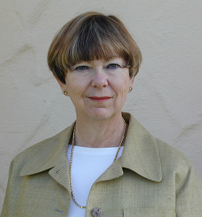
Faculty Information
Dr. Gloria Kuhn is the Vice-Chair for Academic Affairs for the Department of Emergency Medicine at Wayne State University School of Medicine. She completed a residency in emergency medicine at Detroit General Hospital. During this time Dr. Kuhn became interested in medical education. In 1982 she started the first emergency medicine residency at Mt. Carmel Mercy Hospital. This program was the third emergency medicine residency in Detroit and is now one of two emergency residencies sponsored by Wayne State University. In 1990 Dr. Kuhn entered a doctoral program in the College of Education at WSU and received her doctorate in Instructional Technology 1998. Her stated goal during this program was to “teach doctors to teach and assist residents and medical students to learn.” In pursuit of this goal she has been active in faculty development in her department, in the medical school and at a national level. Evidence of her dedication to faculty development is seen in her service on school of medicine committees for faculty development, teaching courses pertaining to education both in her department and at other universities and performing research in education and faculty development. Her work developing national seminars for the Council of Residency Directors in Emergency Medicine that aid junior faculty in their development, and her teaching at the national meetings of the Society of Academic Emergency Medicine on both instruction and faculty development have provided profound direction for her specialty
Disclosure
Dr. Kuhn and all other individuals involved with this activity as planners or content reviewers have no relationship(s) with industry to disclose relative to the content of this CME activity.

Slide 6
"Teaching How to Think Like a Doctor"
“Making Thinking Visible”
Beaumont Hospital
2014
Gloria Kuhn, D.O., Ph.D.
Wayne State University School of Medicine

Slide 7
Overview and Objectives
Define
Components
Traditional apprenticeship
Deliberate practice
SBAR
Advantages

Slide 8
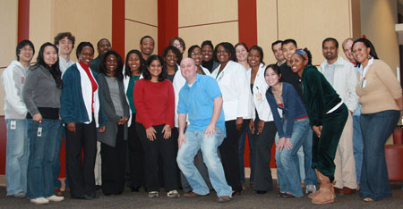
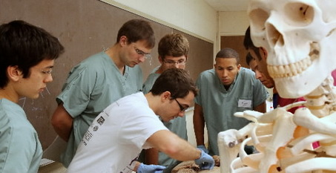
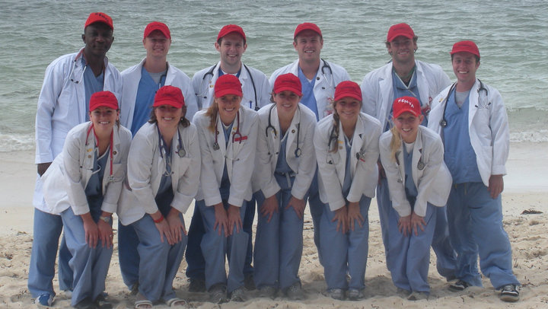
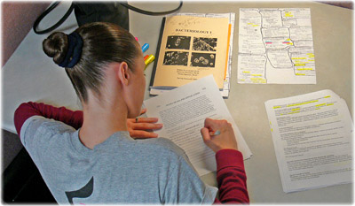
The Goal of Medical School?

Slide 9
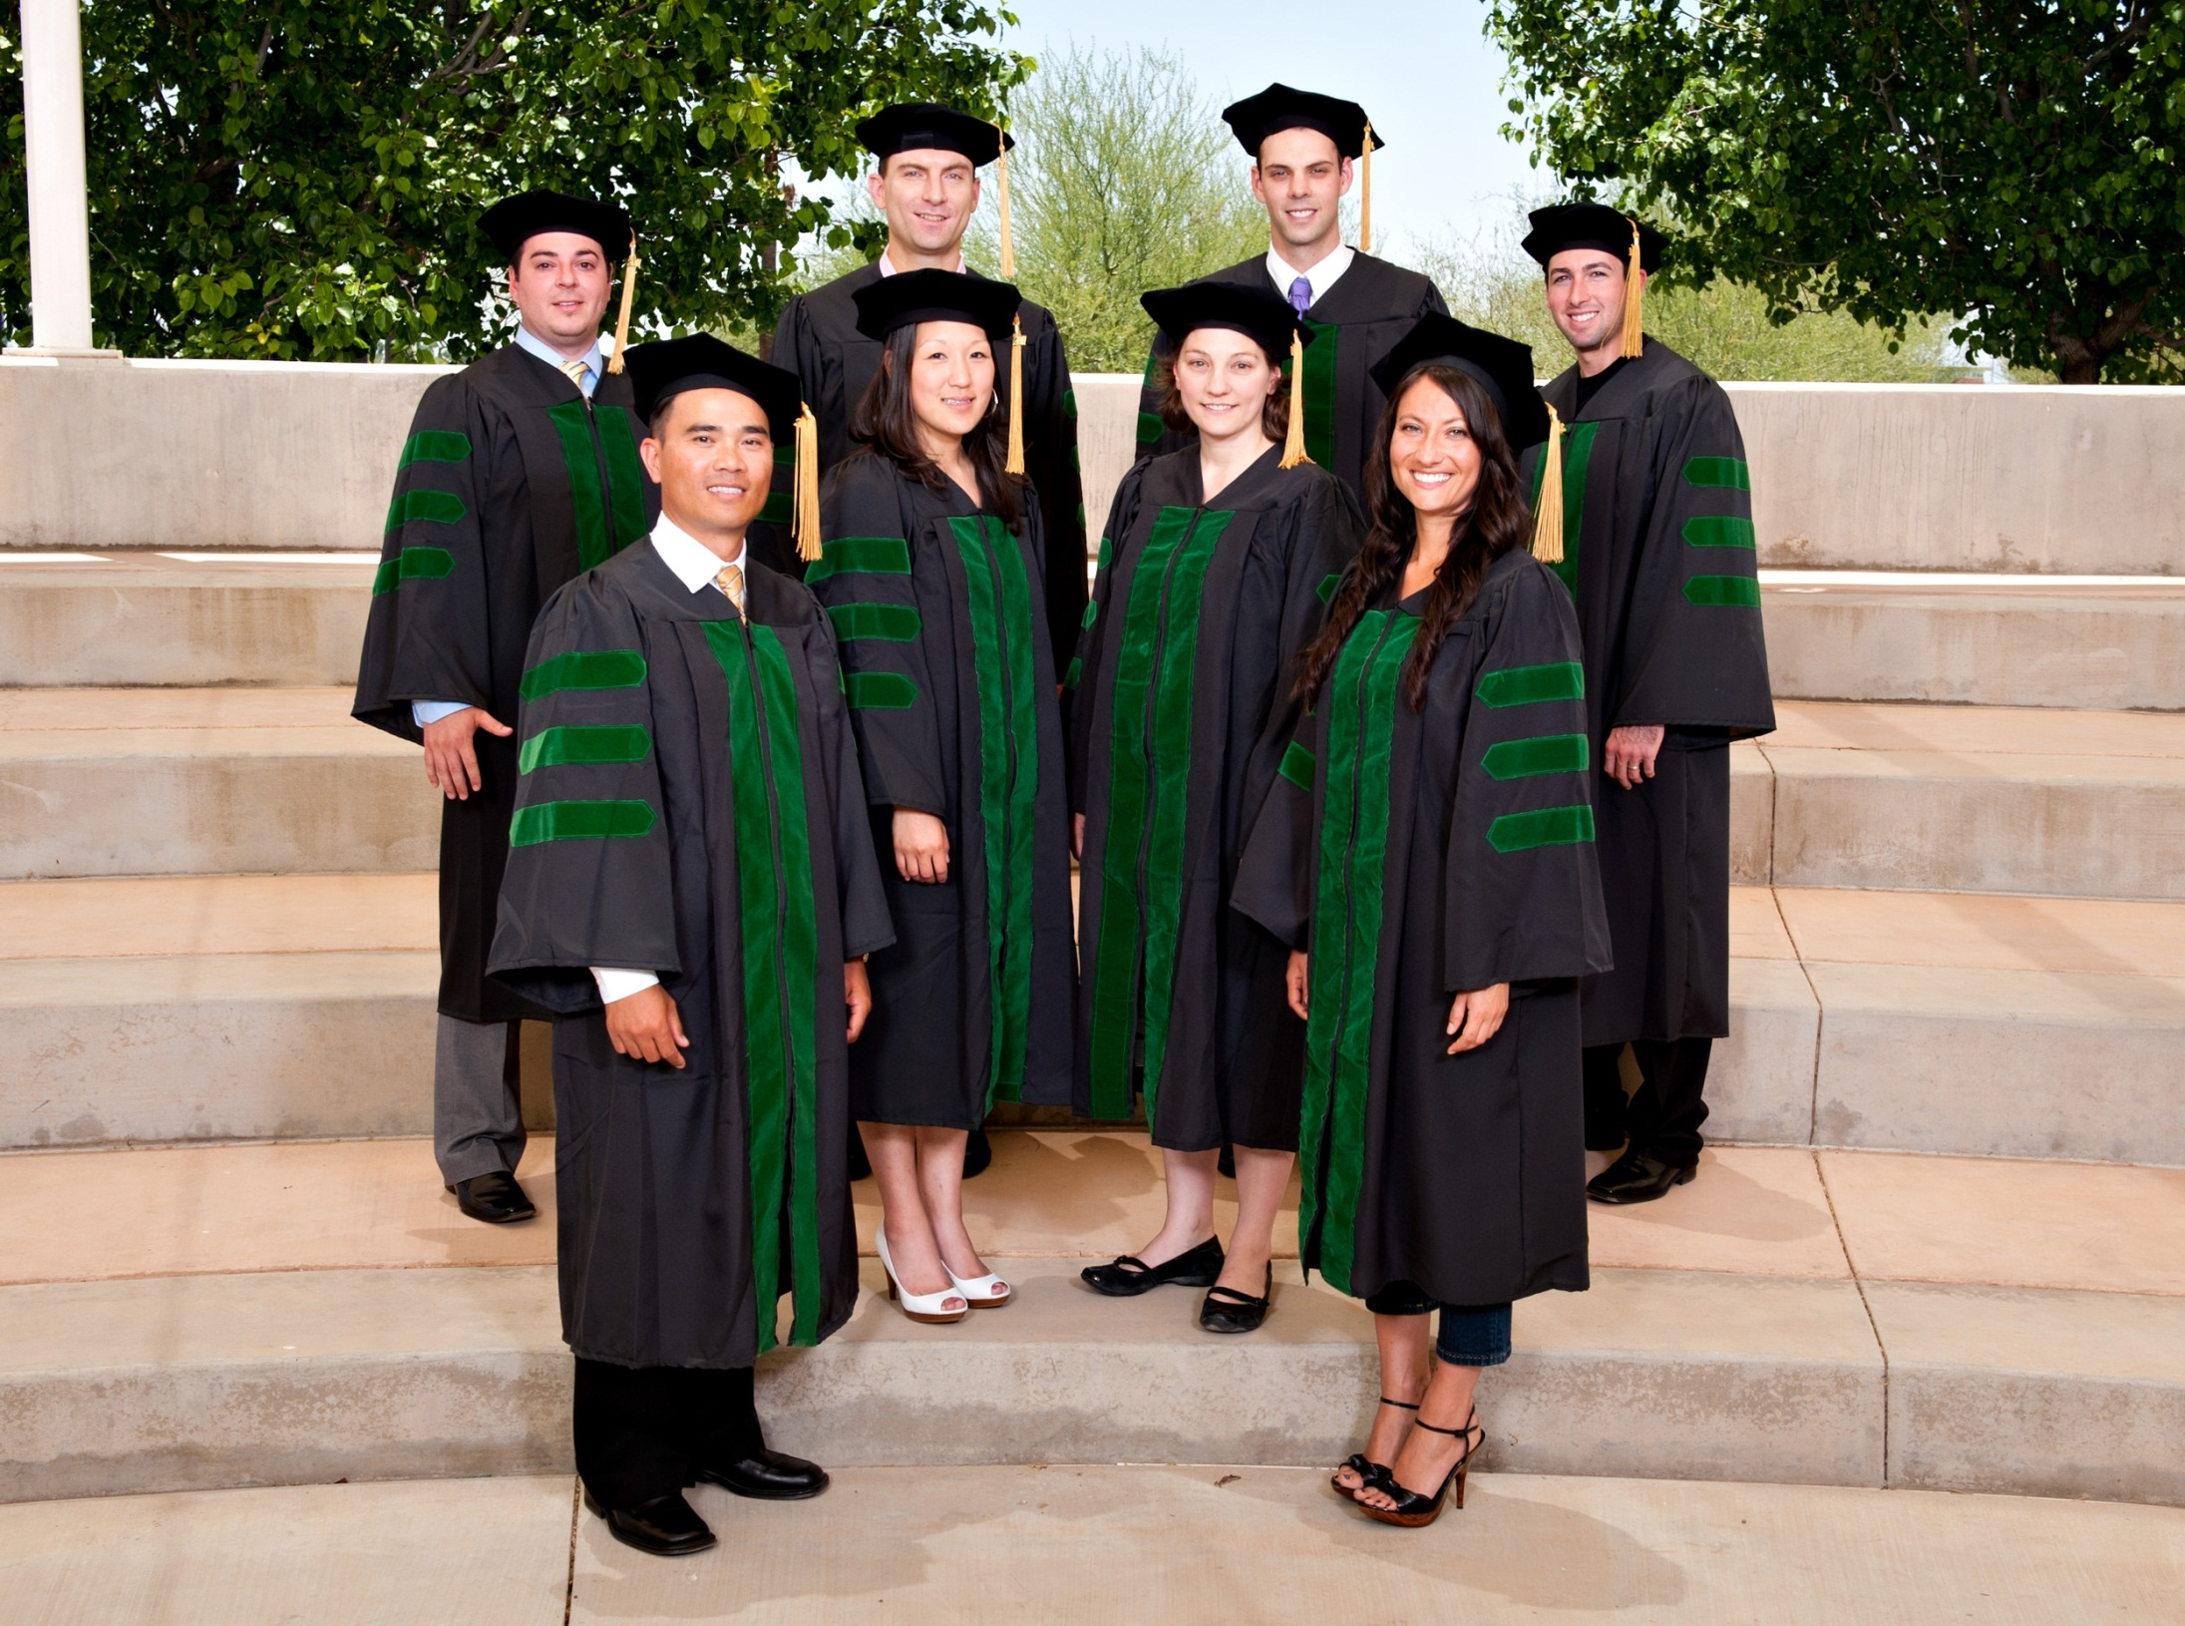

Slide 10
The Goals of the Residency?
Become doctors
Study a lot
Serve patients
Be professional
ACGME Competencies
Milestones

Slide 11
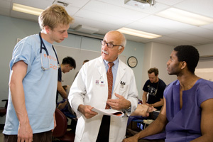
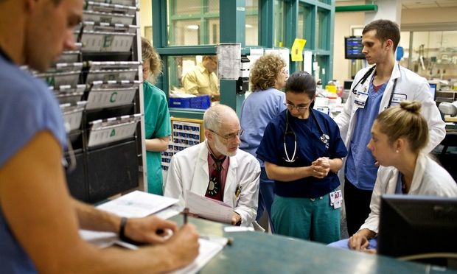

Slide 12
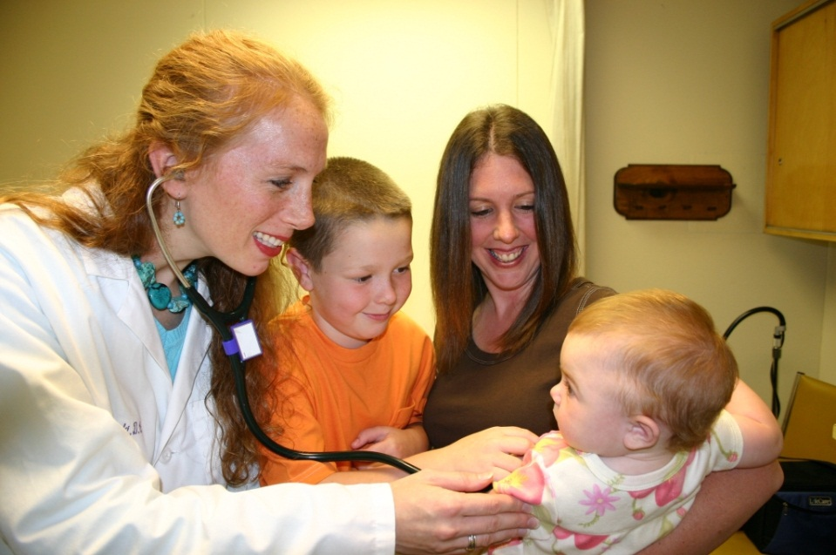
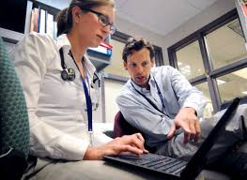
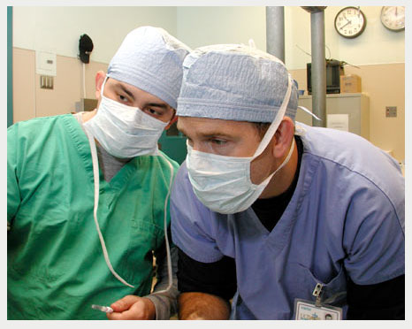
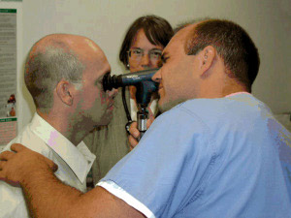

Slide 13
The Goal of a Residency??

Slide 14
Overview and Objectives
Define
Components
Traditional apprenticeship
Deliberate practice
SBAR
Advantages

Slide 15
Outcomes
1. List the components of the cognitive apprenticeship and its value in teaching
2. List the steps in deliberate practice and how it fosters competence and eventual expertise

Slide 16
Outcomes cont.
3. Compare and contrast the cognitive apprenticeship, deliberate practice, and traditional apprenticeship
4. State strategies for integrating all of these methods into teaching

Slide 17
My Goal
Three Models
Cognitive Apprenticeship
Deliberate Practice
Traditional Apprenticeship
SBAR

Slide 18
Definition Cognitive Apprenticeship
Use of the apprentice model to support learning in the cognitive domain to gain cognitive and metacognitive skills.

Slide 19
Cognitive Apprenticeship
Purposes:
see the “thinking of the expert”
understand the “reasoning” expert uses to solve-problems
learn by solving real life problems
“situated” learning

Slide 20
Strategies for implementation
Faculty / learner development
Classroom
Bedside Discussion

Slide 21
Strategies
Classroom
Bedside
Discussion
Faculty/
learner development

Slide 22
Proven Model
Deliberate Practice
1. Goal oriented task
2. Motivation
3. Practice
6. Repetition
6. Reflection
4. Feedback

Slide 23
Why ???
What Happens in the Classroom Stays in the Classroom
Workplace

Slide 24
Examples
Brazilian children

Slide 25
Myself : first case of shock

Slide 26
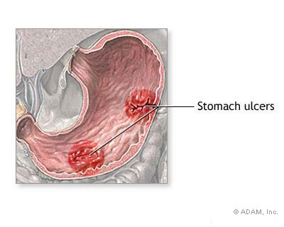
Transfer
Traditional classroom education
Learning???
Unable to use solve real problems
“inert” knowledge
“real life” abilities not used in classroom

Slide 27
Cognitive Apprenticeship
Modeling
Coaching
Articulation
Reflection
Exploration
Scaffolding

Slide 28
Purpose
Expertise
Thinking
Metacognitive skills
Become
You

Slide 29
Definitions
Cognitive
Metacognitive
Strategies
Classroom Situation (situated learning)
Transfer

Slide 30
Comparison
Traditional Apprenticeship (TA)
Long history
Has worked for thousands of years
Empirical proof
Cognitive Apprenticeship (CA)
Recent
Theoretical support
Research support

Slide 31
Comparison cont.
TA
Embedded in work
Steps / end products
Obvious
Competency based
CA
Thinking of expert
Strategies problem solving/ monitoring
Speech
Competency based ?

Slide 32
Radical???
Coaching
Apprenticeship
Modeling
Exploration
Articulation
Scaffolding / fading
Reflection

Slide 33
Theory
Deliberate Practice
Goal oriented task
Motivation
Repetition
Feedback
Reflection

Slide 34
Proof is in the Pudding
Reciprocal Teaching
Multiplication
Writing
Mathematics

Slide 35
Implementation

Slide 36
Not as Big a Rock
Have Trad. apprenticeship model
Deliberate practice model
Cog. Apprenticeship model
Thinking and explanation

Slide 37
Culture Change
Faculty and residents
Shared development
What
Why
How

Slide 38
Implementation Begin in Classroom
You
Case based teaching
Learners
1. Modeling
2. Reflection
Correction
Elaboration
Scaffolding
Coaching
Decision making
Articulation
Refection

Slide 39
Bedside
Beginning of rotation
Set the ground rules
How you will teach
Demonstrate and discuss
Medical students
Interns

Slide 40
Preparing to See a Patient
CC
Vital signs
Information to obtain
History
PE
Discuss

Slide 41
The Presentation
Who
What
When
Where
“I have a 36 year old man with a CC of abdominal pain for the last 8 hours. Came on suddenly….

Slide 42
Their Turn
Setting up for success
Looking at the chart
What information??
Permission to write it down and read

Slide 43
Steps
1. Get chart
2. Reflect on information: chief complaint
3. Ask for help
4. See patient

Slide 44
Paper
Organize thoughts
Supports presenter
Enables them to answer some questions
Compare your decision making with the learner
Presentation more efficient
Higher level discussion

Slide 45
SBAR
Situation CC and Vital signs
HPI
Pertinent PMH (meds, allergies), FH, SH,
PE
Background
Other information

Slide 46
Paper

Slide 47
SBAR Assessment
Differential diagnosis
Why??
Information gathered

Slide 48
RIME????
Reporter
Interpreter

Slide 49
SBAR Recommendations

Slide 50
Reflection
Questions for me | Reading | What I Learned | Changes
Questions for attending

Slide 51
SBAR
Situation: HPI and PE, Meds, Allergies
Background: other information
Assessment
Recommendations

Slide 52
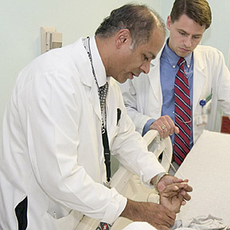

Slide 53
Uses
Expert thinking
All residents
Faster
Struggling resident
Remediation
Feedback and evaluation

Slide 54
Why? Struggling Resident
Memorization
Confusion
Frustration

Slide 55
Summary Making Thinking Explicit
Talking

Slide 56
Deliberate
Practice
Classroom
SBAR
Bedside
Cognitive Apprenticeship

Slide 57
Thoughts

Slide 58
Summary Culture
Cognitive apprenticeship
Deliberate practice
Traditional apprenticeship
SBAR
Development
Integration

Slide 59
Questions and Comments

Slide 60
A Final Thought…
“Tell me and I forget. Show me and I remember. Let me do and I understand.”
Confucius

Slide 61
Reminder: Claim CME/MP Credits Online
https://www.surveymonkey.com/s/ouwb14
IMPORTANT ----- Credits must be claimed online by July 2, 2014;
after this time, CME credit will no longer be available.
CME Activity Code is Required to Claim Credits – See CME Handout
(Code varies based on viewing location)

