Slide 1
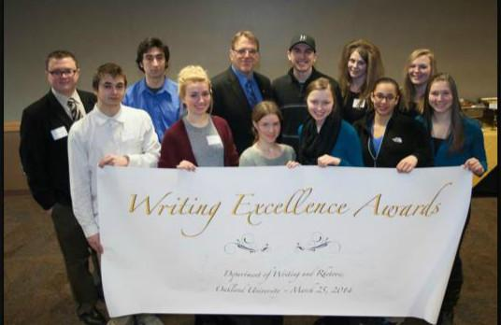
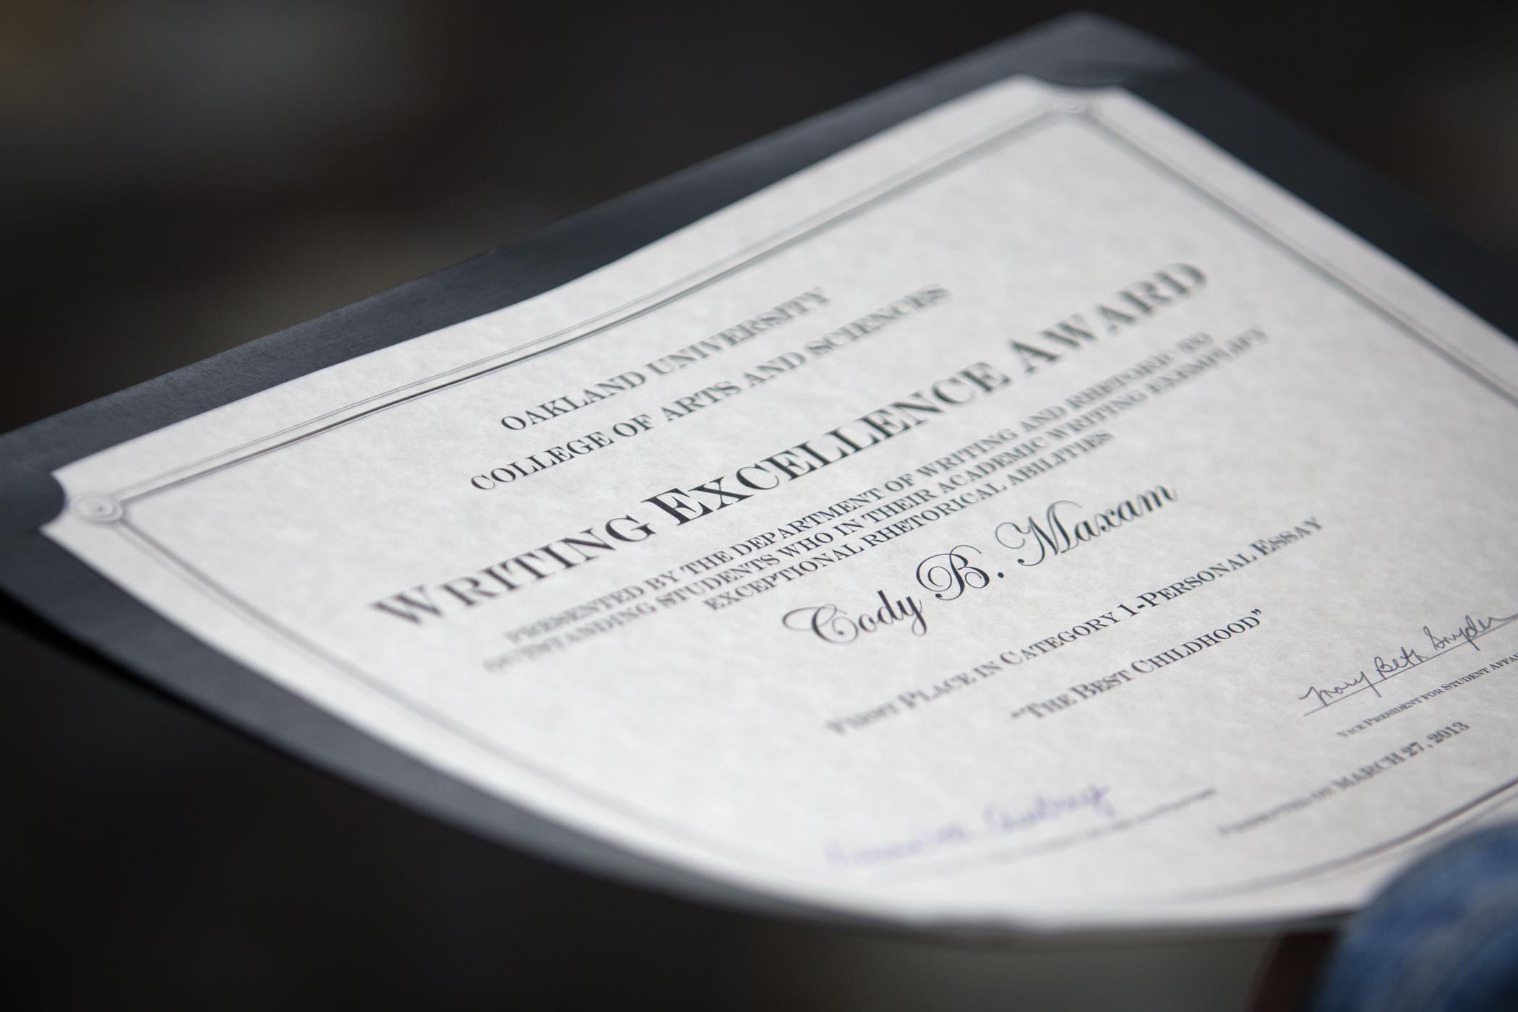
Department of Writing and Rhetoric
Writing Excellence Awards
2015
Tuesday, March 10, 2015
12:00 p.m.-1:00 p.m.
Oakland Room, Oakland Center
2014 WEA Winners
Notes:
Welcome to the 20-something annual Writing Excellence Awards at Oakland University.
we’ve been hosting these awards for over 20 years now in various form.
T
he mission of these awards is to recognize the best of student writing at Oakland, particularly in our first year writing courses, where nearly 3,000 students matriculate through WRT 102, 150, and 160 every year, and to take time each year to celebrate the hard work of our students and instructors.

Slide 2
The Categories
Narrative Essay
from WRT 102, 150, or 160
Research Project
for upper level courses
Analytical Essay
from WRT 102, 150, or 160
Creative Nonfiction
Research Essay
from WRT 160
Multimedia Project
Notes:
This year, we had six categories, three in first year writing, two in upper-level courses, and a multimedia category that spans all levels, and indeed had winners from both first year writing and upper level writing.
We had 162 entries.
These entries represent the best writing at Oakland, and among the best, the award winners represent the top 20% of those – the best of the best.
Before we go any further, I’d like to thank our Writing Excellence co-chairs, David Hammontree and Amanda Laudig for coordinating the submission and judging process, a monumental task in itself, Glen McIntosh Interim VP – Student Affairs for providing funding for the awards ceremony,
Marsha Packer for coordinating the luncheon and dealing with my own organizational challenges, and all of our category chairs, judges, and instructors for their dedication as teachers of writing – often a thankless task but one of the most important at the university. Finally, I’d like to thank the students for their tireless efforts, their talents and skills as writers and thinkers,

Slide 3
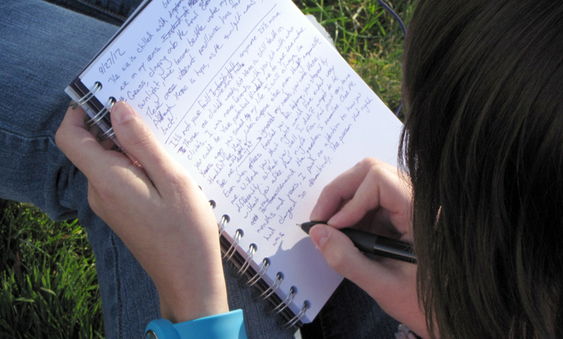
1. Narrative Essay
Category Chair
Benjamin Bennett-Carpenter
Judges
Elizabeth Allan
Amanda Laudig
Pamela Todoroff
Jason Torrente
Outstanding experiential or expressive essays written for WRT 102, 150, or 160. Essays may include some source use and some multi-media content but the focus is on personal expression.

Slide 4
Narrative Essay: Third Place
“Day to Day”
Amber Mazzie
Instructor:
Shaun Moore
Class: WRT 150
“I come home to an empty house. Everyone works opposites shifts. You would think there are only two ends of opposite, but it turns out there's at least four. I change out of my uniform immediately. I sit for what feels like the first time all day to reply to the text messages I got 4 hours ago.
‘Guess what happened at school today!!’ My best friend, Kristen, lives two and half hours away from me.
‘Hey sorry I missed this. If you're still up I can text. If not, get me back tomorrow. I wanna know what happened.’”

Slide 5
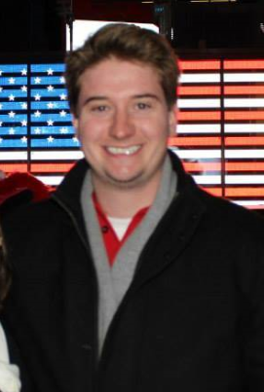
Narrative Essay: Second Place
“Collaborate”
Shawn Ryan Howe
Instructor:
Marshall Kitchens
Class: WRT 150
“Pre-millennial and young millennial generations need to start looking to us 80’s babies as interpreters to serve the digital immigrants in helping them become fluent in what the digital natives were born into.
We were there when life was still simple and innocent, we grew up around all of the advancing technologies, and we’ve changed with technology to incorporate it into our personal and professional lives.”

Slide 6
Narrative Essay: First Place
“The Value of Money According to Me”
Karalyn Suzanne Smith
Instructor:
Jennifer Coon
Class: WRT 150
“The first time that I realized that my family was poor, I was eight years old and my twin sister and I had asked my mother if we could have a Playstation 2 for our birthday. When we were greeted with Gameboys instead, we were distraught. A Gameboy is a smaller handheld device that pales in comparison to the beautiful, gleaming, black Playstation 2, a home gaming console. The Gameboys cost my mother $60 for two of them, but the Playstation 2, at the time, was around $300. That is not to say I was completely oblivious to our financial situation before. This was just the first time that I was really struck by the importance of money.”

Slide 7
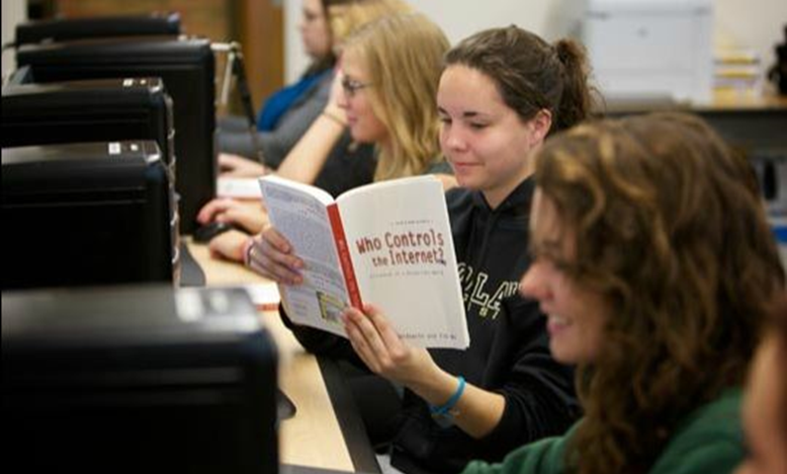
2. Analytical Essay
Category Chairs
Glen Armstrong
Colleen Doyle
Judges
Timothy Briggs
Tara Hendin
Lisa Hine
Marshall Kitchens
Laura Klein
Josephine Walema
Outstanding analytical essays written for WRT 102, 150, or 160. Projects may use some secondary sources and multi-media content but the focus is on primary research, such as case study, ethnography, or textual analysis.

Slide 8
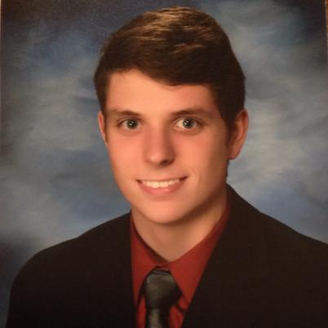
Analytical Essay: Third Place
“Veganism: A Rhetorical Argument on the Principles
of Health, Environmental Restoration, and
Animal Rights.”
Alexander Joseph Boundy
Instructor: Jason Torrente
WRT 160
In his analytical essay, “Veganism: A Rhetorical Argument on the Principles of Health, Environmental Restoration, and Animal Rights,” Alexander Boundy concludes that much of what PETA claims in their literature is true. He goes on, however, to deftly argue that “celebrity vegans and testimonials” hinder PETA’s overall credibility. He finds a more evenhanded rhetorical approach in Nicole Oca’s Veganism: The Silent Healer, “a fact-based documentary that [provides] the viewer with a logical and credible argument on the health effects of a vegan diet.”

Slide 9
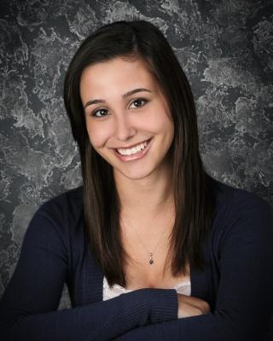
Analytical Essay: Second Place
“Use of the Term ‘Friend’ Among Oakland University Undergraduate Students.”
Madison N. Tilley
Instructor: Amanda Laudig
Class: WRT 160
Madison N. Tilley delves not only into the meaning of the word “friend” in her original research, but just how we use the word on Oakland University’s campus. “Use of the Term ‘Friend’ Among Oakland University Students” explores the word’s complexities through clearly delineated primary research. She concludes that though campus males describe a friend with “basic or even sarcastic answers,” all of the student subjects here suggest that “the term ‘friend’ is only given to people who ‘earn it,’” a conclusion with rich implications when applied to our interactions on social media sites such as Facebook.

Slide 10
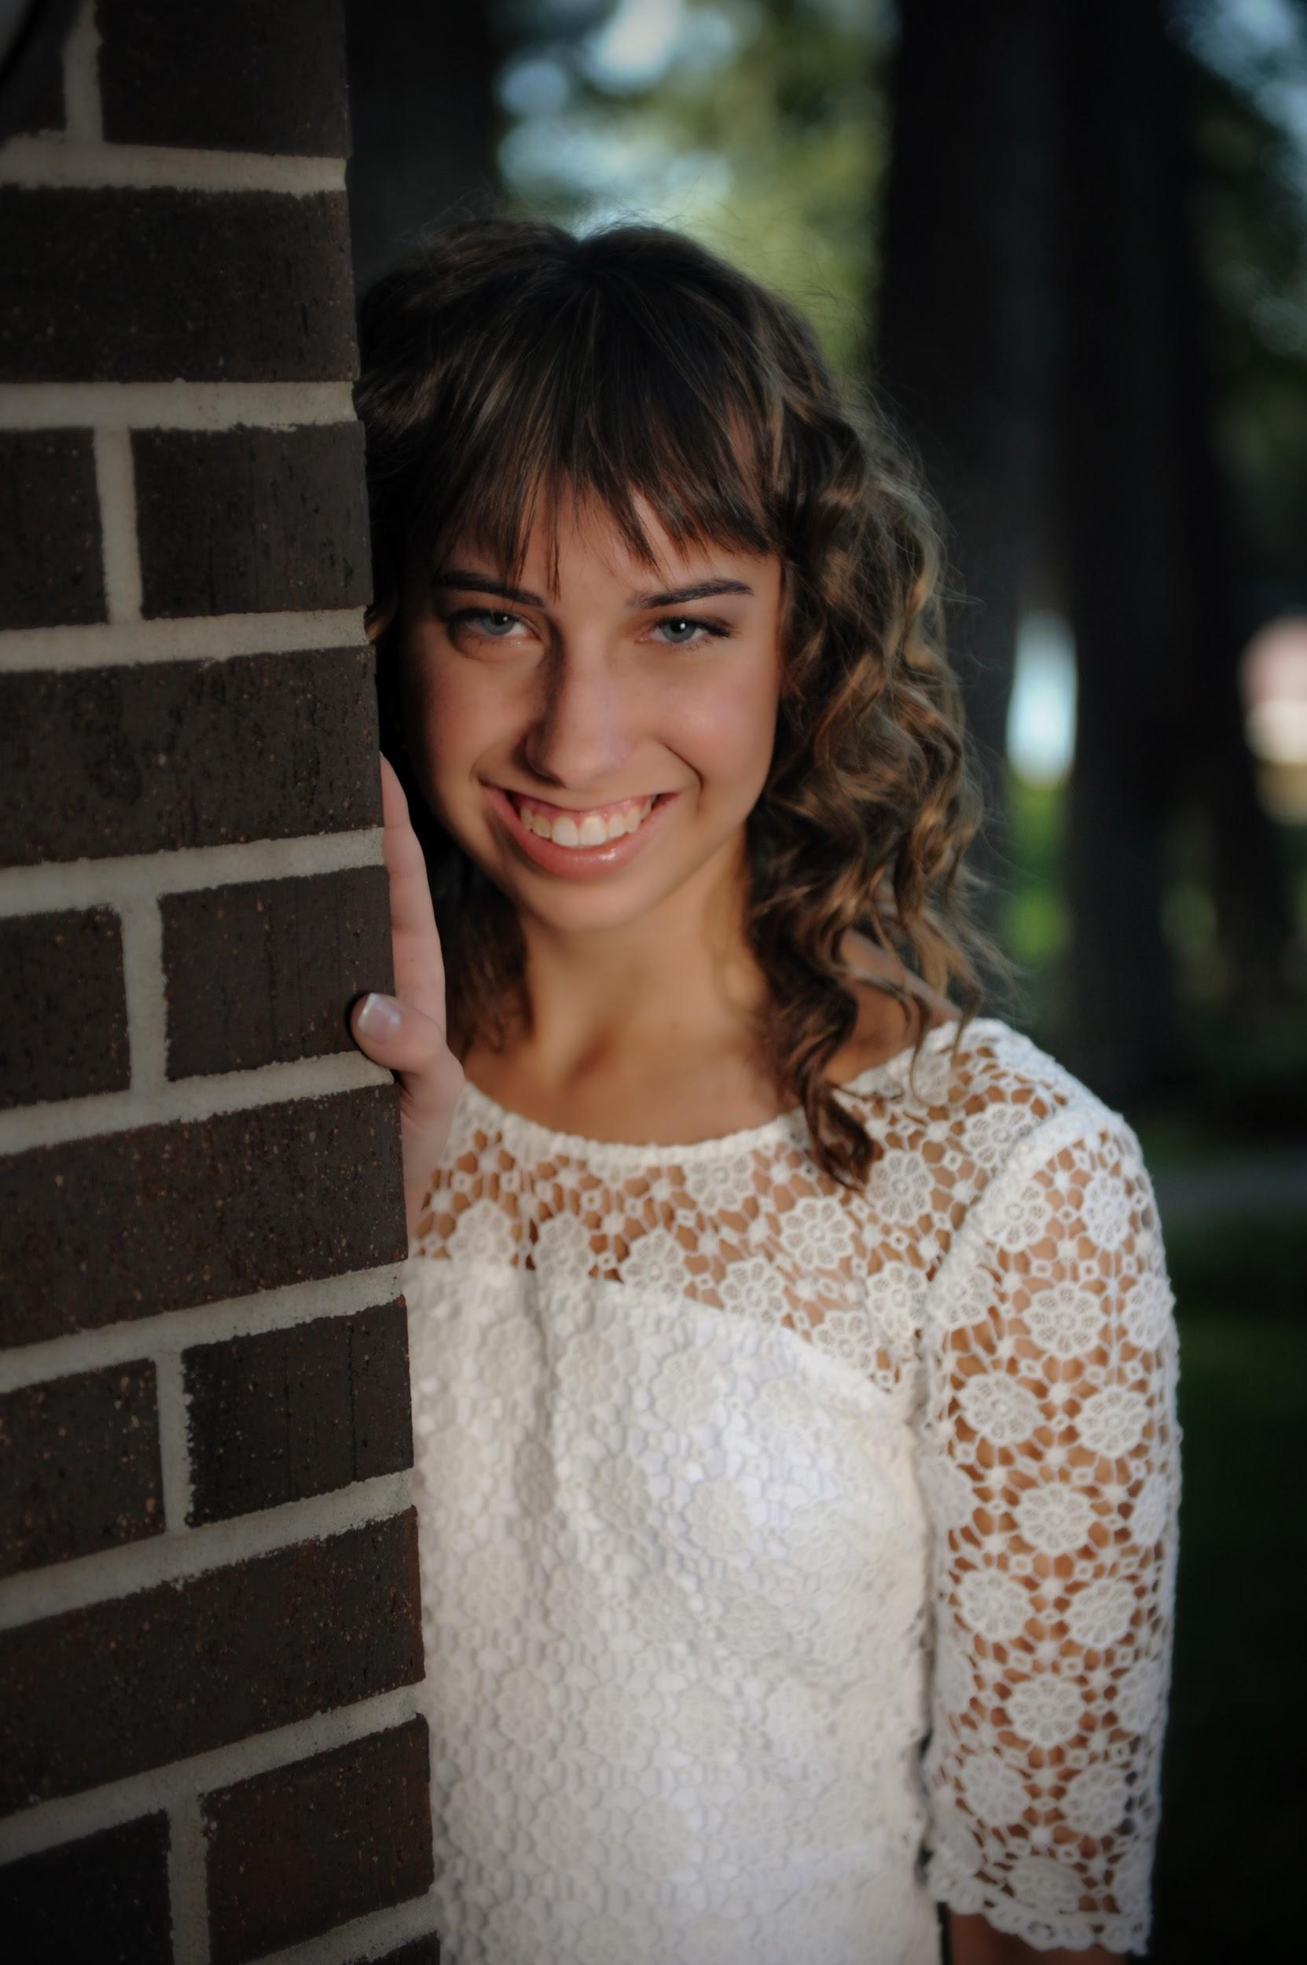
Analytical Essay: First Place
“Plans of Care to Promote Progress”
Jessica Rose Walukonis
Instructor:
Instructor: Elizabeth Allan
WRT 150
In “Plans of Care to Promote Progress” Jessica Rose Walukonis explores both the rhetorical and the practical implications of electronic medical records, reminding us that “the physical therapy workplace is now seeing a blend . . . of paper documents and electronic medical recording.” Addressing future professionals, she concludes that critical thinking and metacognition are key to both intellectual growth and skill acquisition.

Slide 11
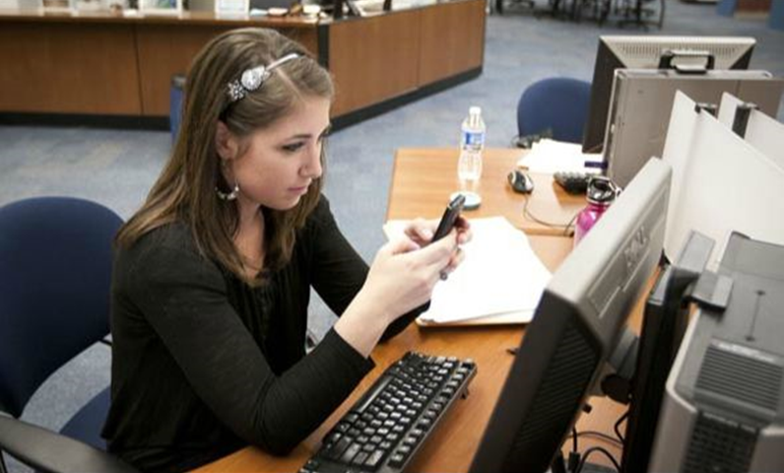
3. Research Essay
Category Chairs
John Freeman
Cathy Rorai
Marilyn Borner
Judges
Felicia Chong
Dana Driscoll
Emily Freeman
Cathy McQueen
Cindy Mooty-Hoffman
Sherry Wynn Perdue
Kathy Skomski
Melissa St.Pierre
Lauren Rinke
Outstanding research essay written for WRT 160. Features include developing new knowledge,synthesizing sources effectively, and documenting appropriately in APA format. Essays may include some multi-media content and primary research, but the focus is on making new meaning using secondary sources.

Slide 12
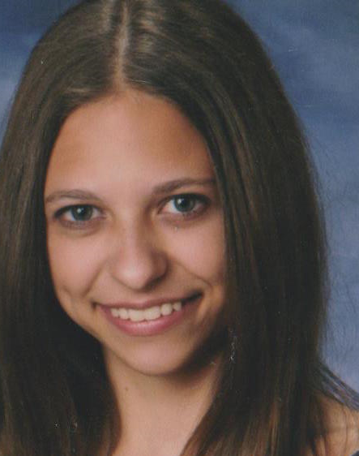
Research Essay: Honorable Mention
“Simulation Innovation: A Discussion
of Veterinary Medicine”
Caroline Cencer
Instructor:
Laura Klein
Class: WRT 160
“The purpose of this compiled research is to prove that all veterinary students need
sufficient access to simulation labs. For my primary research, I surveyed a class of Oakland University nursing students about their experience with the simulators. It was determined that the students do appreciate having access to the simulators. My results and the findings of other studies confirm my argument that it is clear that simulators do assist students in becoming even more efficient and confident in their future careers.”

Slide 13
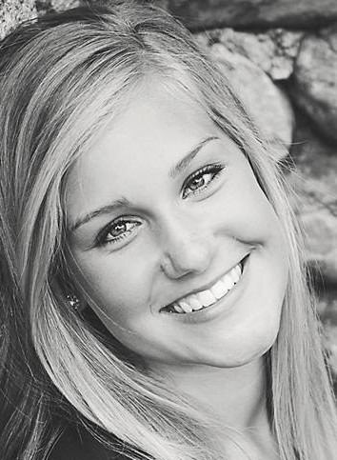
Research Essay: Honorable Mention
“Creating the Best Distance Runner”
Ashley Lynn-Burr
Instructor:
Wallace May Anderson
Class: WRT 160
“Understanding the time of recovery the body needs is also an important
factor, and can impact success as well. Along with that, the mental aspect and coping with stress are key to optimal performance. Every person is unique, and one method of training may work for some and not others. The best runners have deeply analyzed themselves and learned what does and does not work for them, and have therefore adjusted their training and habits to be as successful as possible.”

Slide 14
Research Essay: Third Place
“The Sustainability of Bitcoin”
Musaab Muhamaad
Instructor:
John Freeman
WRT 160
“Bitcoin is an open, unstructured, mathematically-based, online currency that is neither backed by a government nor a commodity, also known as crypto-currency. Today, Bitcoin has slowly been accepted as a mainstream currency online, like the USD and Mexican dollar. Some vendors now allow customers to pay their purchases with Bitcoin. Currently, a debate exists in the financial world about whether Bitcoin is sustainable as a currency—or even if it should be considered a currency at all. The paper will examine the challenges experts foresee for Bitcoin in the upcoming decade, from internal technical issues to broader economic and legal ones.”

Slide 15
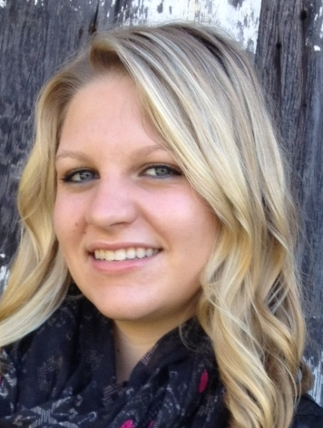
Research Essay: Second Place
“Power of Praise: Positive Behavior Support
in Early Childhood Education”
Kaylee Blanchard
Instructor:
Cornelia Pokrzywa
Class: WRT 160
“Positive Behavior Support (PBS) is prevalent in daycares and early childhood education programs. PBS is a form of discipline where the focus is on prevention and praise rather than punishment (Snell, Voorhees, Berlin, Stanton-Chapman, Hadden, & McCarty, 2012). Additionally, function-based intervention is a theory that explores motives behind challenging behaviors in order to find ways to stop and prevent them; this idea works well with PBS as it works to create environments that support positive behavior (Dunlap & Fox, 2011). I conducted an interview with Assistant Professor Dr. Julie Ricks-Doneen, who explained how PBS and discipline is handled in a real education center.”

Slide 16
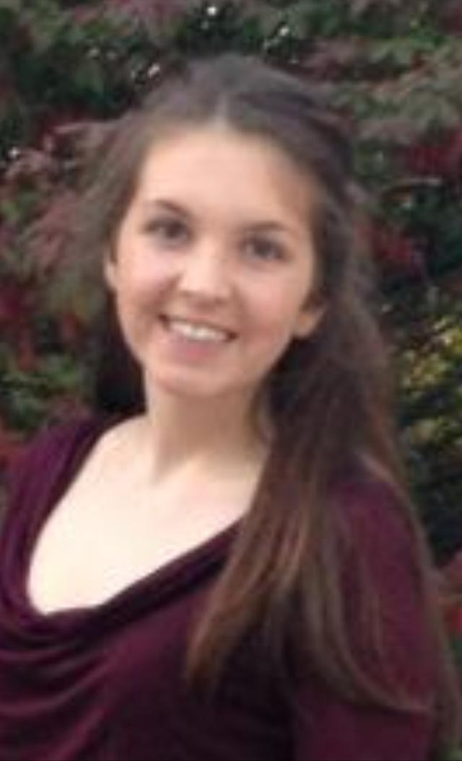
Research Essay: First Place
”Prison Rehabilitation and Its Effects”
Elizabeth Kellogg
Instructor:
Laura Klein
Class: WRT 160
“In this paper, the issue of increasing prison rehabilitation programs, and the effects they have on both inmates and society are discussed. Since the Progressive movement began in the early 20th century, various attempts at rehabilitating inmates and curbing criminal behavior have been trialed. In recent decades, however, the focus of prisons became not to rehabilitate prisoners, but instead punish them. Recent studies show that this policy has proven to be disastrous,”

Slide 17
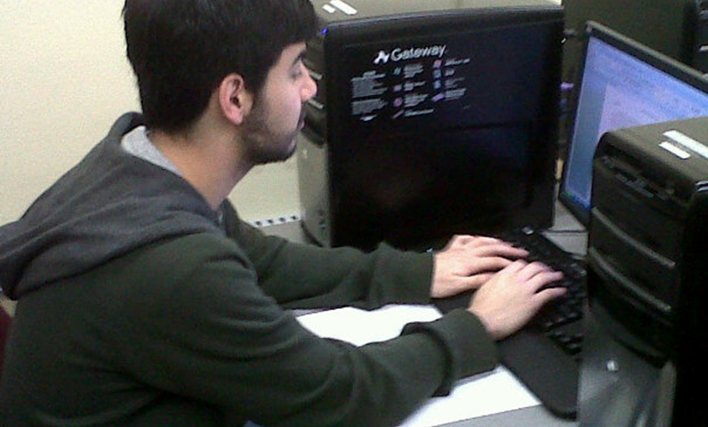
4. Research Project
Category Chairs
Matthew Burkett
Judges
Jill Chrobak
Alice Horning
Bill Rouster
Crystal VanKooten
Outstanding formal research project for any upper-division WRT or general education writing intensive course. Features include developing new knowledge, synthesizing sources effectively, and documenting appropriately. Essays may include some multi-media content and primary research.
Notes:
Text below Research Project reduced to 13 pt to fit.

Slide 18
Research Project: Third Place
“The Importance of Correct Technique/Biomechanics
in 100/110 Hurdle Racing”
Hayley MacDonald
Instructor: Brian R. Goslin
Class: EXS 350
“Proper form consists of a quick forward motion of the lead leg, with flexion at the hip joint as well as flexion and extension at the knee joint, a speedy trail leg that is tucked under the body’s center of gravity and brought back down to the ground vigorously, and rapid arm movements that will force the legs to run and clear a hurdle as quickly as possible. Ultimately, if a hurdler can learn to incorporate the proper technique and mechanisms discussed within this research paper into their training, he or she will experience great success in their hurdling career.”

Slide 19
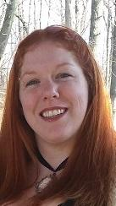
Research Project: Second Place
“Internal Language Barrier: Addressing Disconnects in
Discourse at the Collegiate Writing Level”
Megan Anne Phelps
Instructor: Greg Giberson
Class: WRT 491
“By including students’ native dialects and utilizing their NDC [native discourse conventions] in the classroom, we, as a discipline, can show students the validity of their ideas and help them build the self efficacy necessary to gain self-esteem in their writing—a task that will undoubtedly provide the inclusive environment necessary for students to understand the importance of adaptability within the university.”

Slide 20
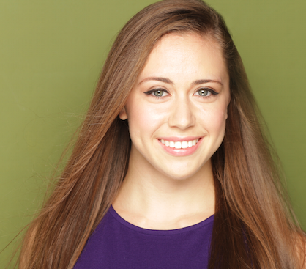
Research Project: First Place
“The Presence of Cultural Rhetoric
in Traditional Music”
Lauryn Johnson
Instructor:
Josephine Walwema
Class: WRT 360
“It is clear how deeply rooted our culture is within us—all the way down to our brain—and how closely related music and culture are. The traditional music of a region reflects the values, customs, beliefs and logic of its people. Each musical style is as different as the people that created them and the histories that surround them. But in studying the rhetoric of music across cultures, you will also find some innate similarities due to the commonalities present among all of humanity.”

Slide 21
5. Creative Nonfiction
Category Chairs
Marilyn Borner
Judges
Wallis May Andersen
Karen Brehmer
Christina Moore
Emily Francis
Greg Giberson
Amanda Laudig
Lori Ostergaard
Outstanding non-fiction essay written for upper-division WRT or writing intensive general education courses. Projects may use some secondary sources and multi-media content but the focus is on personal expression in writing.

Slide 22
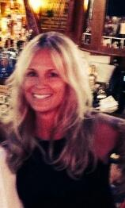
Creative Nonfiction: Third Place
“The Last Day of Summer”
Sandra Flury-Gardner
Instructor:
John Freeman
Class: WRT 386
“As I coast into the cemetery entrance, I am perplexed how this day that I dedicate to my mother each year, so often turns to reflections of my father. I suppose I know my father better. I have certainly known him longer (thankfully he is still with us). My mother, I knew for a mere 17 years. My mom feels distant to me. I am unable to remember the exact pitch of her voice or the particular shade of brown in her eyes. She is more of a feeling now, time has stolen her, she is the sun beyond the fog, blurry out of reach.”

Slide 23
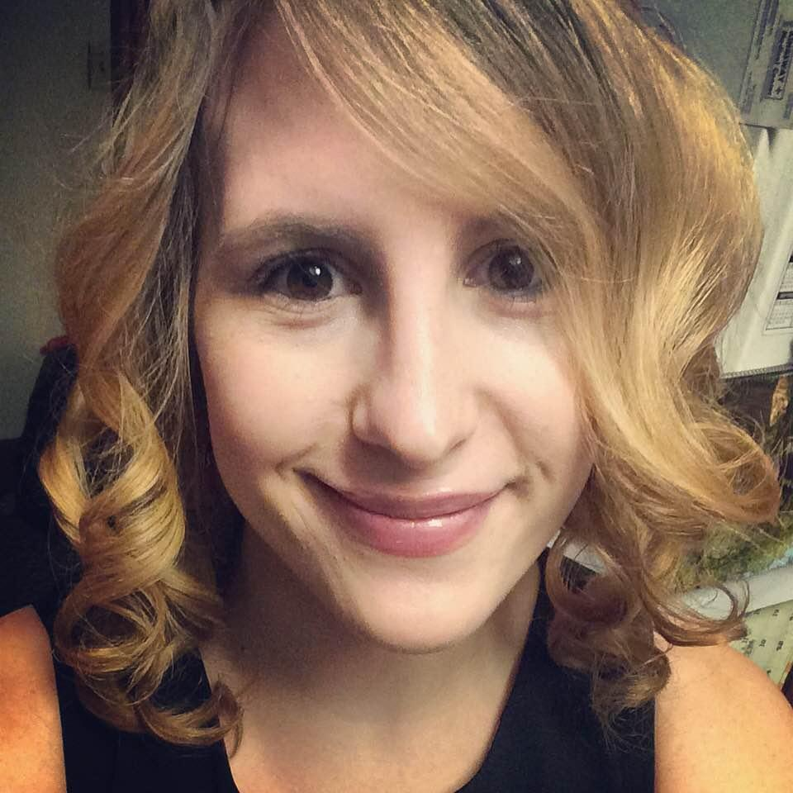
Creative Nonfiction: Second Place
“An Argument with My Brain”
Angela Marie Spinazzola
Instructor:
Glen Armstrong
Class: WRT 386
“I remove the cash and count the number of twenties, count the number of twenties by twos, count the twenties by ones. Lock up the tills. Lock the back door. Pull on the locked door. Check the locked drawer with the tills and walk back. Pull on the back door, once and then twice. Check the locked drawer and pull twice. Punch in the code. Lock the front door and pull on the handle. Pull on the handle again. Again, pull on the handle. Walk to the car with co-worker and ask, “Did I lock the door?” “Yes.” Once she leaves pull up and check the front doors. Again, pull on the handle once and then twice.”

Slide 24
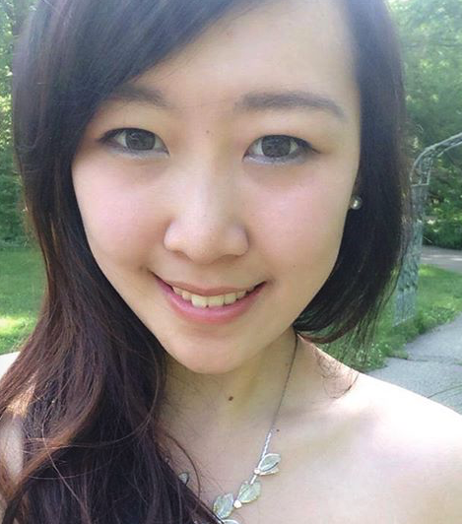
Creative Nonfiction: First Place
“Clara: A Story”
Marissa Zhu
Instructor:
Marshall Kitchens
Class: WRT 386
“That night the yelling and screaming was particularly intense. The yelling was punctuated by a banging so loud it shook the floors of our apartment. …
I stared at the wall, trying to imagine the scene on the other side, trying to see what Clara was doing right now. The voices faded after about half an hour. For the rest of the night, I tried to strain my ears for a hint of Clara's voice. Nothing.
The next day, I banged on Clara's fence at 4:30 PM. She wasn't there. No one came out. Clara never reappeared on her side of the balcony again.”

Slide 25
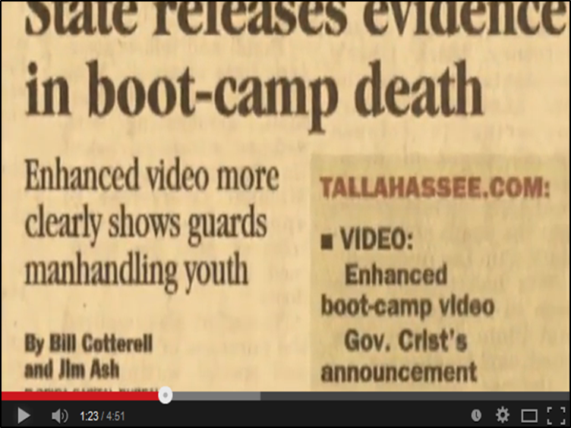
6. Multimedia Project
Category Chairs
Rebecca Rivard
Laura Gabrion
Judges
Sheryl Ruszkiewicz
Kasia Kietlinska
Craig Smith
Katie Lieder
Jenna Katz
Outstanding multi-media project written for any WRT course or writing intensive general education course. Projects may be any combination of text, graphics, audio, and video but focus is on elements other than text.

Slide 26
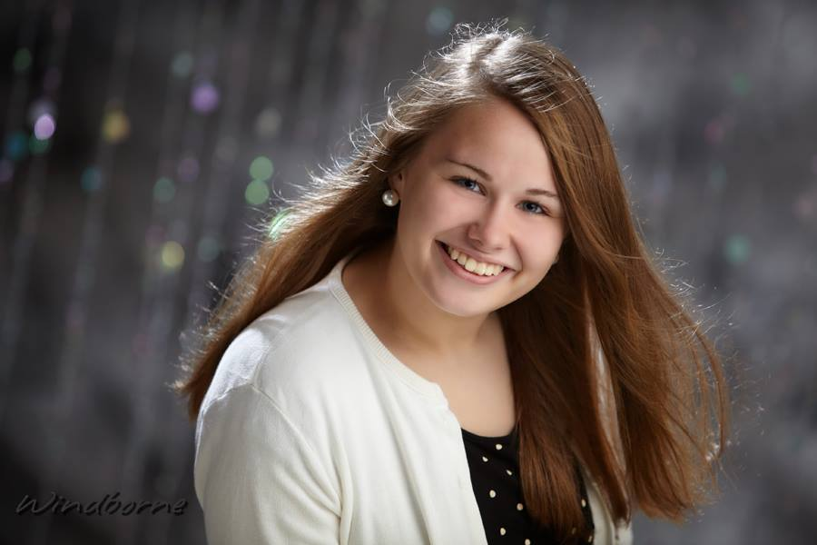
Multimedia Project: Third Place
YouTube Video: “Writing and Communication in Secondary Education”
Megan Luttinen
Student Author
Instructor:
Cindy Mooty-Hoffman
Class: WRT 150

Slide 27
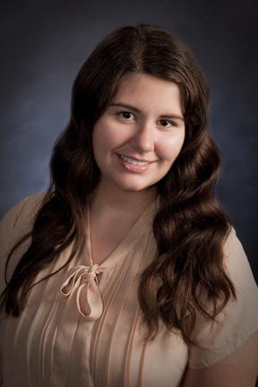
Multimedia Project: Second Place
Prezi: “Remember the Past: Mandate Holocaust Education”
Alexis Clark
Instructor:
Cindy Mooty-Hoffman
Class: WRT 160

Slide 28
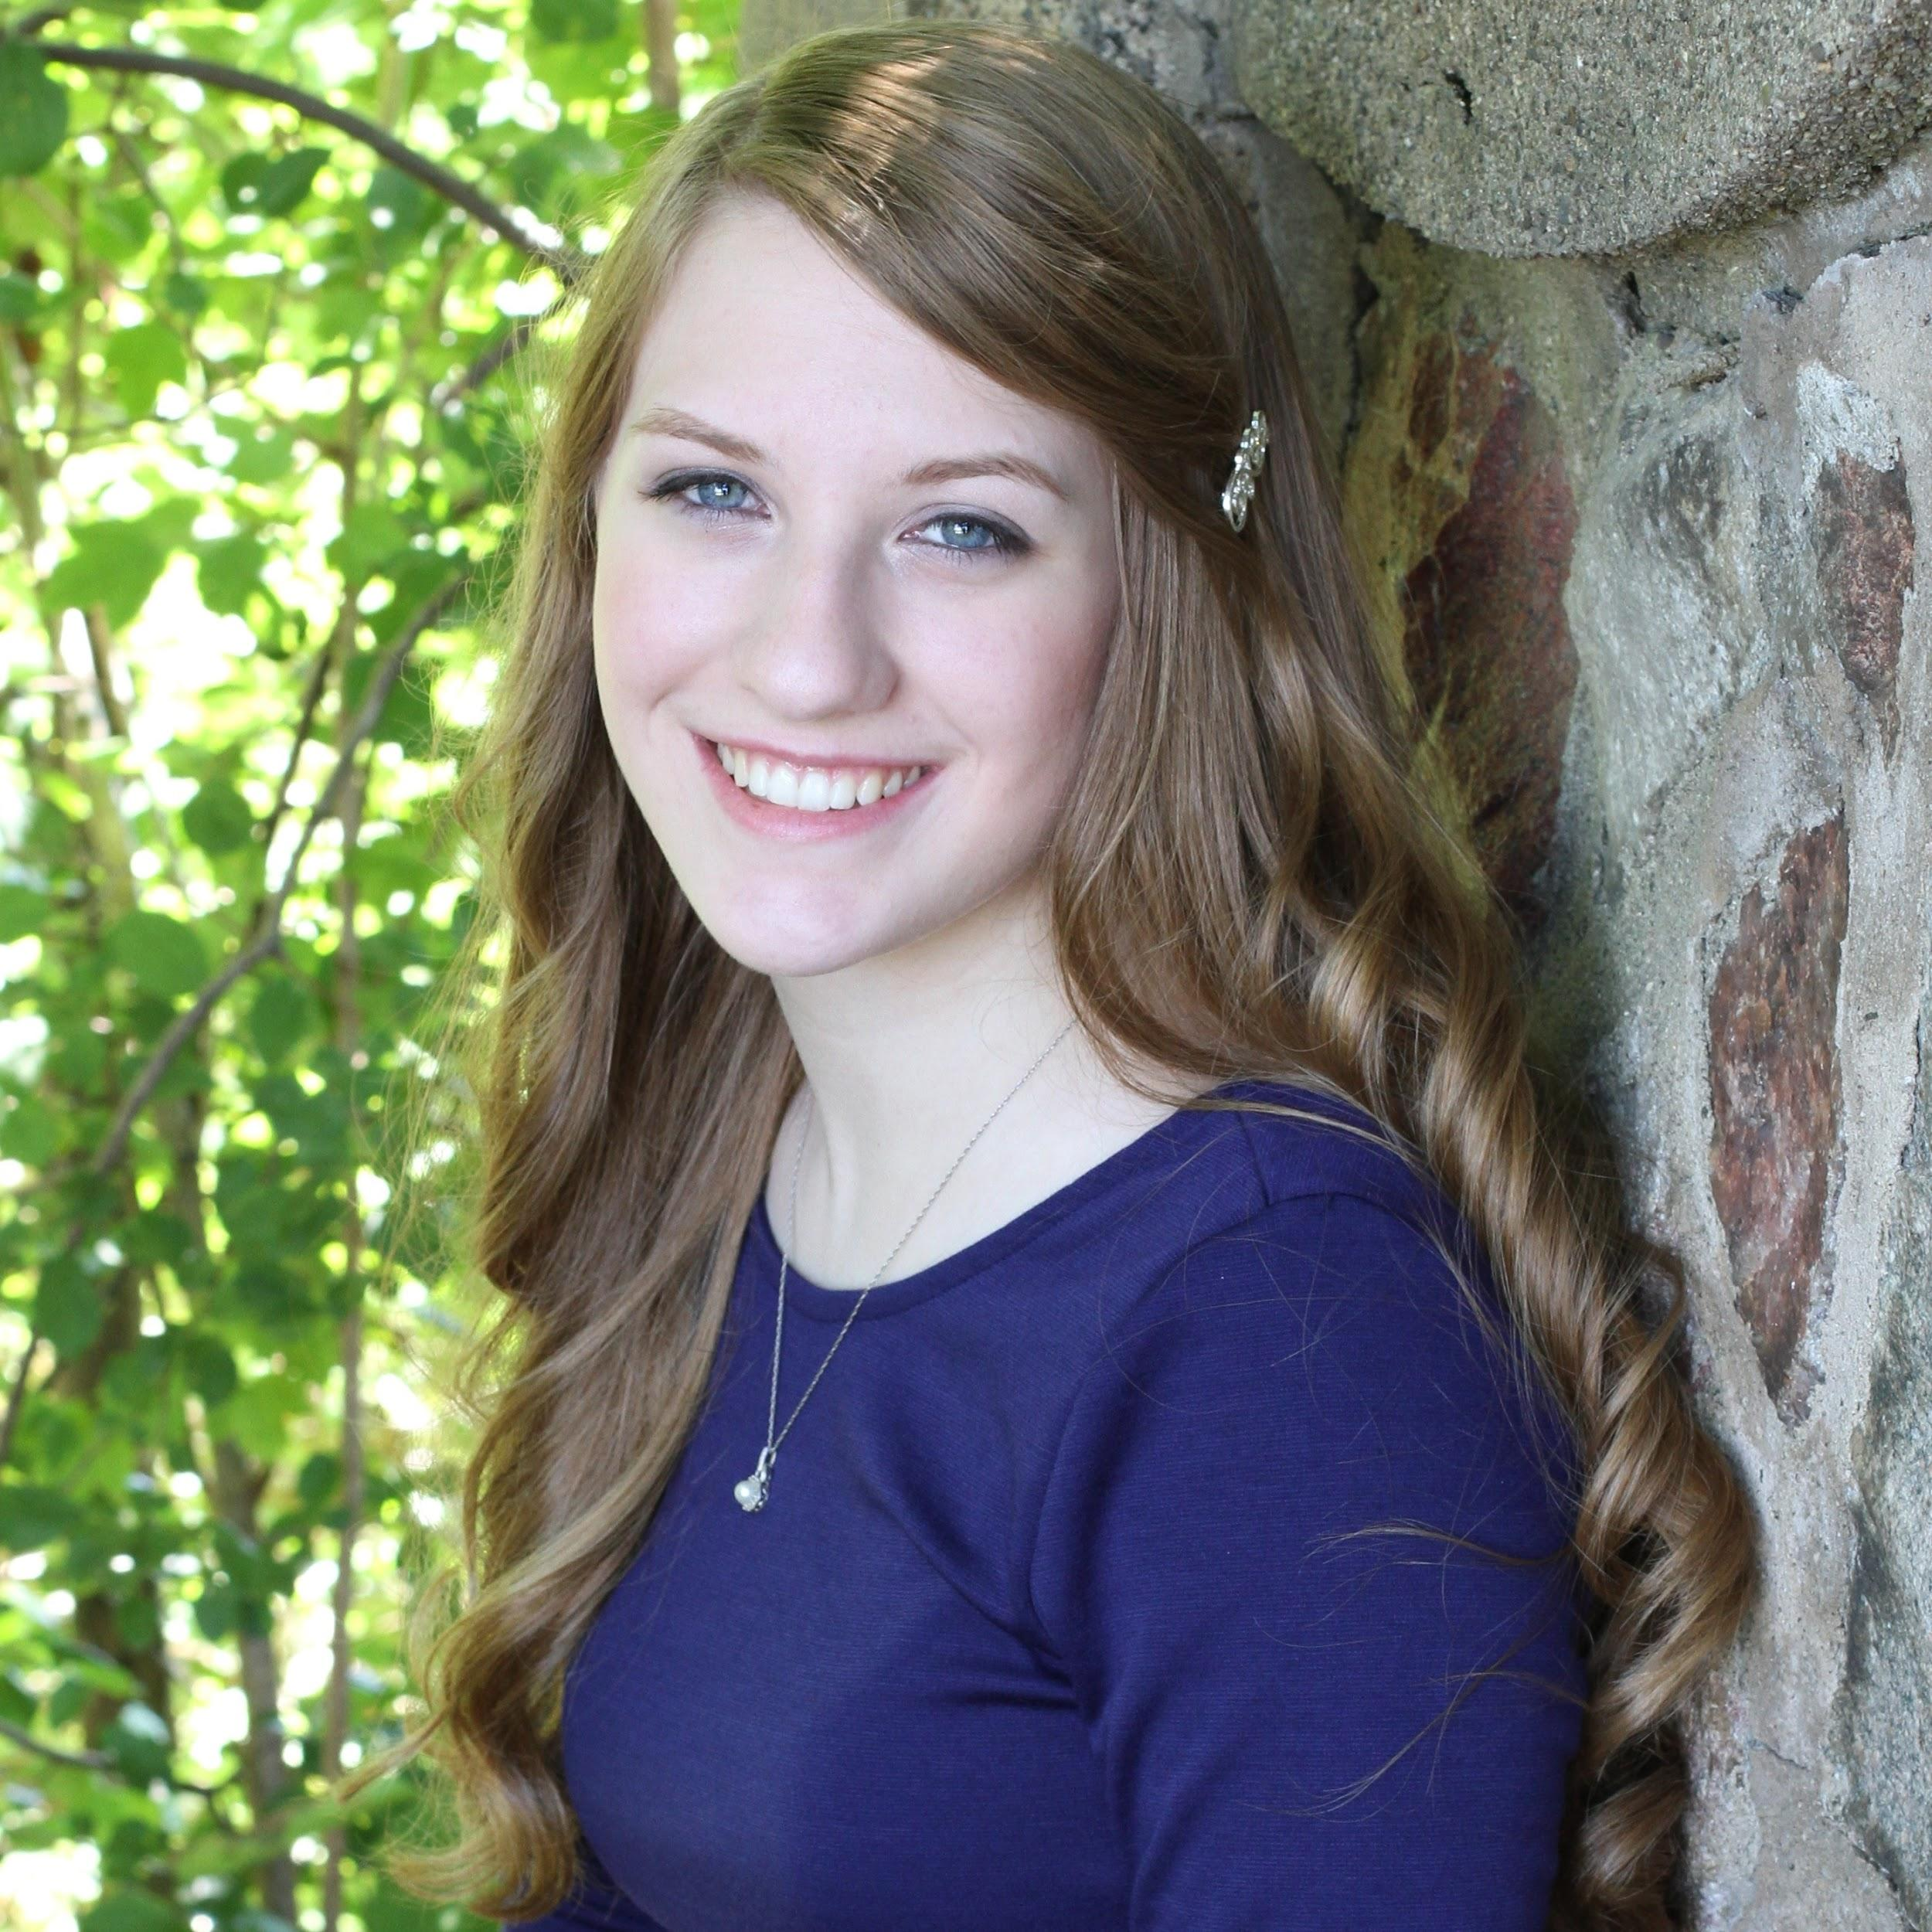
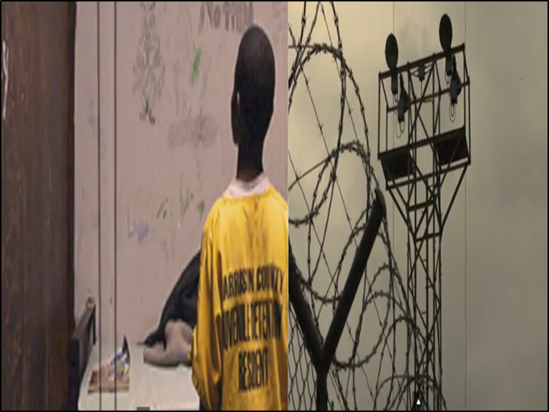
Multimedia Project: First Place
YouTube Video: “The Throwaway Kids”
Eden Hartley
Instructor:
Timothy Briggs
Class: WRT 160

Slide 29
Department of Writing and Rhetoric
Writing Excellence Awards
2015
Tuesday, March 10, 2015
12:00 p.m.-1:00 p.m.
Oakland Room, Oakland Center
2014 WEA Winners
Notes:
Welcome to the 20-something annual Writing Excellence Awards at Oakland University. I’m Marshall Kitchens, chair of the Department of Writing and Rhetoric, and we’ve been hosting these awards for over 20 years now in various form.
The mission of these awards is to recognize the best of student writing at Oakland, particularly in our first year writing courses, where nearly 3,000 students matriculate through WRT 102, 150, and 160 every year, and to take time each year to celebrate the hard work of our students and instructors.

