Slide 1
Graham Health Center
Travel Medicine

Slide 2
Graham Health Center Services
Primary Care Services
Physical Exams: For work, travel, school, sports, annual screening, etc.
Health Maintenance: Asthma, Thyroid, Birth Control, Allergy shots, etc
Disease Prevention: Health talks: Safe sex practices, Immunizations: Flu, MMR, HPV, Td, Tdap etc
Diagnose and treat – lab on site
Acute illness: Step throat, UTI, STI/STD’s, Mono, HIV, Allergic reactions, Cerium impaction, etc, Emergency Services: AED, CPR, Anaphylaxis, Respiratory distress/arrest etc
Minor Injuries: Sprains/strains, lacerations, minor burns, chemical exposures, etc
Chronic disease: Diabetes, STD management, High blood pressure, etc
Screening tests: Lab work, Peak flows; Tympanogram, Rapid strep, Mono, Pregnancy testing, HIV, STI etc
Prescribe medication: + small dispensary: OTC meds: ibuprofen, cold/cough medicine, condoms etc; + some RX meds
Promote positive health behavior & self-care skills through education & counseling.

Slide 3
Psych – Mental Health Services
Psychiatrist: 4 hrs weekly + Full time Psych Mental Health Nurse Practitioner
Provide Psych Intakes (diagnosis, medication & resource determination/prescribing).
Prescribe & manage appropriate medications for depression, anxiety, bipolar + multiple other mental health issues
Work in collaboration of the GHC Counseling Center
Work in collaboration with the Wellness Coordinator: Stress reduction, Relaxation, Sunlight therapy, Mindfulness and Meditation consult.

Slide 4
Travel Medicine Services Now Available! For your health & safety, convenience and cost savings
For Study Abroad programs as well as personal travel for students, faculty, staff and other colleges/universities affiliated with OU travel abroad program
Travel Consultations
Physical Exams
Immunizations
Prescriptions
Individualized Travel Kits

Slide 5
Travel Consult
Travel Consult
Review country specific recommended / required travel Immunizations
Review your current immunization status & identify immunization needs or gaps.
Provide immunizations needed for travel – (Subject to vaccine availability).
Identify related medication needs, both maintenance: i.e. Epi pen, extended RX for personal medications; AND / OR preventative RX i.e. for traveler’s diarrhea, malaria.

Slide 6
GHC Travel Services (con’t)
Review up-to-date health risks/safety concerns and advise accordingly.
Written or on-line sources on country specific information on everything from health risks, disease info, personal risk, currency etc.
Optional purchase of a medical travel kit with commonly needed items such as acetaminophen (Tylenol), Mosquito repellant, Ibuprofen, Imodium, Anti-acids etc. (Prices vary based on contents of individual kits)
Prescriptions written / or (depending on medication) option for dispensing of medications needed for common travel illnesses (i.e. traveler’s diarrhea; Malaria).

Slide 7
Immunizations
Hepatitis A Vaccine: Contracted thru contaminated food and water – via direct contamination or food handling. 2 shot series: 0 & 6 months
Hepatitis B Vaccine: Blood borne 0, 1 month, 5 months
Tetanus/diphtheria (Td) or Tetanus/diphtheria/pertussis vaccine Tdap: 1 adult Tdap, then Td every 10 yrs.
Typhoid vaccine: Contracted through contaminated food and water: inj: 1 shot every 2 yrs.
Polio 1 booster as adult – in addition to childhood immunization
Rabies: Pre-vaccination – 3 shot series: 0,7 & 21 or 28 days. (Post exposure vaccination still needed after exposure – only 2 shots if you had the rabies vaccine and 5 if not).
Japanese Encephalitis: 2 doses, 28 days apart.
Yellow Fever – current shortage: 1 every 10 yrs.

Slide 8
Travel Programs: Comparing Costs
Clinic | Beaumont R/O | Passport Health-Troy | Walgreens | Troy Internal Medicine | OU- GHC
Consultatation Fee | $75 | $80 | Not offered | $90 | $60*
Bill Insur | No | No | No | No | Yes
Sample Vaccine cost (per single dose)
Hepatitis A | $100 | $120 | $113.99 | $100 | $75
MMR | $95 | $115 |  |  | $85
Typhoid | $100 | $130 | $95.79 | $95 | $80
JE |  |  |  | $305 | $292
Polio |  |  |  | $60 | $48
* Group discounts available

Slide 9
O.U. Travel Abroad Destinations
Europe 237 programs
Spain: 75 programs
Asia 82 programs
China: 36 programs
South America: 50 programs
Argentina: 24 programs
Brazil: 15 programs
Africa: 37 programs
Senegal: 9 programs
Ghana: 8 programs
S. Africa: 8 programs

Slide 10
Europe
All routine immunizations (MMR, Tdap, Hep B etc) UTD
Recommended: Hep A (2 shot series 0, 6 months)

Slide 11
Asia: China
Hep A
Typhoid
Polio booster
? Rabies / ? JE - depends on region, outdoor exposure, time of year.
Flu shot (depending on time of year).
+ All routine immunizations (MMR, Tdap, Hep B etc) UTD.

Slide 12
South America
Hep A
Typhoid
? Yellow Fever

Slide 14
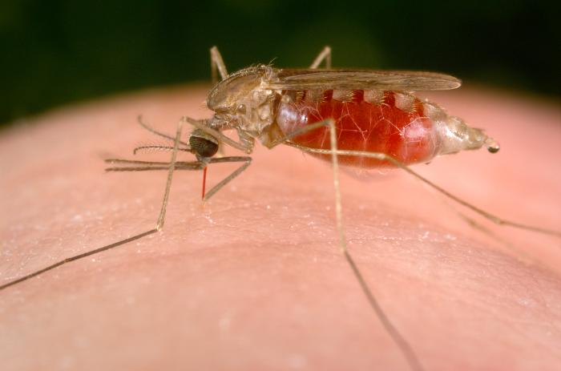
Diseases Spread by Mosquitos
Malaria is a disease spread through mosquito bites. Symptoms usually appear within in 7-30 days but can take up to one year to develop. Symptoms include high fevers, shaking chills, and flu-like illness. Without treatment, malaria can cause severe illness and even death.
Yellow fever is a disease caused by a virus that is spread through mosquito bites. Symptoms take 3–6 days to develop and include fever, chills, headache, backache, and muscle aches. About 15% of people who get yellow fever develop serious illness that can lead to bleeding, shock, organ failure, and sometimes death.
Japanese encephalitis (JE) is a disease spread through mosquito bites. Symptoms usually take 5-15 days to develop and include fever, headache, vomiting, confusion, and difficulty moving. Symptoms that develop later include swelling around the brain and coma. JE is a serious disease that may cause death.
Zika virus: Zika is spread mostly by the bite of an infected mosquito. These mosquitoes bite during the day and night.Zika can be passed from a pregnant woman to her fetus. Infection during pregnancy can cause certain birth defects.Can be transmitted via sexual contact Symptoms: Fever; Rash Joint pain Red eyes Other symptoms include: Muscle pain; Headache
Dengue Fever

Slide 15
Chikungunya fever (CHIK) is an infection caused by the Chikungunya virus (CHIKV). The virus is spread through the bite of an infected mosquito, Symptoms may include: Sudden high fever (usually > 102ºF) which may be continuous or intermittent. Severe joint pain that commonly involves the hands and feet Joint swelling; Back pain; Rash usually 2-5 days after fever starts Other symptoms may include headache, body ache, nausea, vomiting, and redness around the eyes. In unusual cases, infection can involve the brain, eyes, heart, kidney and other organs.
Fatal infections are rare, however many patients have chronic joint pain, arthritis, loss of energy and depression lasting weeks to years.
Dengue Fever has emerged as a worldwide problem since the 1950s. Although dengue rarely occurs in the continental United States, it is endemic in Puerto Rico and in many popular tourist destinations in Latin America, Southeast Asia and the Pacific islands.

Slide 16
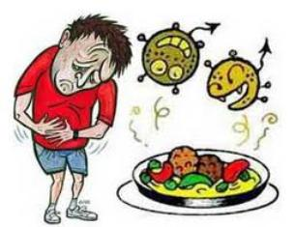
Contaminated food & water
>Hepatitis A
>Polio
>Typhoid
>Traveler’s diarrhea
>Cholera
>Food poisoning

Slide 17
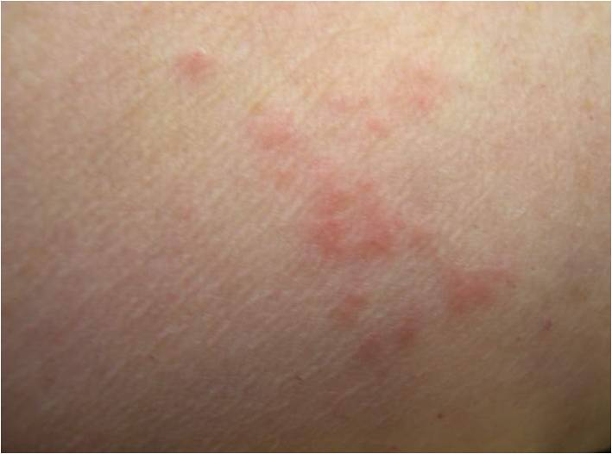

Slide 18
Stress/Depression/Anxiety (The Chronical of Higher Education, June, 2010)
Close to 30 % of college students surveyed reported being very depressed at some point in the past year (triple the number just 15 years ago).
6 % of college students reported seriously considering suicide in the past year
Underlying mental-health problems can be exacerbated by the stress of studying overseas, as students adjust to being alone in a foreign country, far from friends and family.
Yet study-abroad offices have one hand tied behind their backs when it comes to mental-health concerns, because they do not have access to students' medical records.

Slide 19
GHC: 248-370-2341

