Slide 1

Employment
@
Oakland University
Staying in Compliance with New Regulations

Slide 2
Gail Ryckman University Human Resources - Employment Services Kathryn Wrench Grants, Contracts & Sponsored Research Leigh Settlemoir Dzwik Academic Human Resources Roger Maki-Schramm Student Financial Services/Student Employment Office Julie Delaney Graduate Study & Lifelong Learning Michele St. Denis Accounts Payable David Archbold International Students & Scholars
Presentors

Slide 3
Employment @ Oakland University
Purpose of this Meeting
Introduce
Educate
Reinforce

Slide 4


Government Agencies

Slide 5
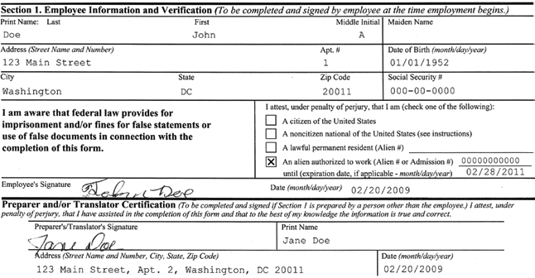
Government Agencies

Slide 6
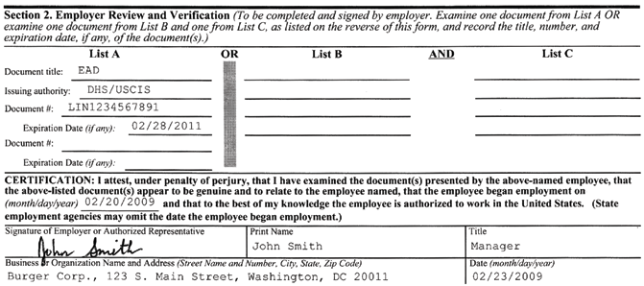
Government Agencies

Slide 7

Government Agencies

Slide 8
Government Agencies
E-Verify
Mandated Compliance
Automated process
Data to DHS Immediately
Including the start date
Automated authorization to work

Slide 9
Employment @ Oakland University
Will E-Verify Affect Me?
You are darn right it does!
Zero tolerance on late paperwork
DO NOT allow employees to work without authorization

Slide 10
Government Agencies
Department of Homeland Security – Immigration & Customs Enforcement (ICE)
Audits
Failure to Comply
Civil Money Penalties
Up to $1,100 per violation
Loss of grants and contracts

Slide 11
Employment @ Oakland University
What Can We Do To Help?
Train
Answer questions
We can’t help you if you don’t help us.

Slide 12
Employment @ Oakland University
Types of Employment
Faculty/Researchers (AHR)
Student (Student FS – SEO)
Graduate Assistant (Grad Study)
Staff (UHR)

Slide 13
Office of Grants, Contract and Sponsored Research
Why is E-Verify required and how will it affect me?
Contract Clause 52.222-54 implements use of E-Verify to confirm authorization to work in the U.S.;
E-Verify is designed to reduce violations of U.S. immigration law;
The requirement applies to all OU employees, not just personnel funded by federal research agreements.
The requirement affects all new hires and some existing employees.
Notes:
E-Verify is a compliance requirement of the federal government that is designed to reduce the instances of violations of U.S. immigration laws. When you leave here today, you will have an understanding of the steps required to legally hire employees at Oakland University. Hiring employees affects most of what we do at the university and in the performance of sponsored research, but it’s important for me to emphasize that E-Verify is a part of all employment processing at the university. It affects faculty, staff, students, guest scholars and all employment at Oakland. Violation of E-Verify could affect sponsored funding and financial aid resources at the university which would have a severe impact on our ability on our educational mission.

Slide 14

The largest portion (about 70%) of program cost in sponsored research is personnel.
E-Verify significantly affects the hiring process;
Personnel required to be verified as authorized to work in the U.S. are;
Yes: Faculty
Yes: Student Workers – Graduate and Undergraduate
Yes: Visiting Scholars
Yes: Staff
Yes: All Other Employment Classifications
Yes: Subcontracted personnel at other institutions
No: Consultants are not employees and are not required to be E-Verified, refer to APP#262

Slide 15
Office of Grants, Contract and Sponsored Research
All personnel working on existing federal contracts that contain Clause 52.222-54 are required to initiate E-Verify confirmation within 30 days.
All newly hired OU personnel are required to be initiate E-Verify confirmation within 3 days of hire.
Notes:
E-Verify implementation for grants and contracts basically means that all personnel will be E-Verified. The federal government mandates that all employees paid from the contract must be E-Verified. If you ever wish to pay someone from federal sponsored funding, that person must be E-Verified. This requirement would affect a cost transfer request to appropriately apportion personnel for the time spent working to benefit the federal contract. So, though we are implementing E-Verify for all new employees, the federal mandate will also affect existing employees who are paid from a federal contract award. You should begin the E-Verify process as soon as is practical for these employees.

Slide 16
Office of Grants, Contract and Sponsored Research
E-Verify affects the ability to begin work on a contract. Because NEW EMPLOYEES ARE REQUIRED TO BE E-VERIFIED WITHIN 3 DAYS OF THE START OF WORK, you may not begin work prior to verification.
E-Verify affects cost transfers. Because EXISTING EMPLOYEES ARE REQUIRED TO BE E-VERIFIED WITHIN 30 DAYS, retroactive cost transfers beyond 30 days of the start of work on a federal contract will not be approved.
E-Verify affects subcontracting work to another entity. Because OU IS RESPONSIBLE TO CONFIRM SUBCONTRACTOR COMPLIANCE with E-Verify, we must confirm subcontractor E-Verify registration and obtain their assurance of compliance.
Notes:
Beginning work on a federal contract is a sticky issue under E-Verify. E-Verify is most stringent for new employees, so this means that the entire process must begin as early as possible for new employees. Do not start work and anticipate that the employee will be paid from a sponsored agreement/federal contract. If the employee is not E-Verify compliant, the funding source will not be a federal contract. The point that I want to emphasize is that we are here to help far in advance and to clearly outline the new requirements and we need your assistance to comply with the requirement. If you have questions, need assistance, have special situations, etc. we need to talk about those issues and find solutions before a problem occurs. After the employee starts work, we are unable to fix any problem because we’re non-compliant at that point. We are here to assist with remaining in compliance with our funding requirements.
Because the requirement is to initiate this process within 30 days of assignment to the contract, retroactive transfers will not be permitted outside of the 30 day window. This significantly affects research administration because there was no previous requirement other than a standard of reasonableness. Beyond 60 days, we required a justification, but there was no period certain that a cost transfer could not occur. Due to E-Verify, it is necessary to implement a requirement that a cost transfer cannot occur to transfer the effort of an employee to a federal contract if the request is more than 30 days beyond the start of work.
Subcontractors are already required to provide information to GCSR that includes compliance with federal regulations. Again, beginning this process early (at the proposal stage) helps OU to remain compliant with the regulations. If the subcontractor has not enrolled with E-Verify at the time of award, OU would not be able to complete a contractual agreement. This could become an issue if not addressed early on, so please be aware that subcontractors are required to comply with E-Verify.

Slide 17
Academic Human Resources
AHR assists the academic departments with the employment of:
Academic Administrators & Deans –
AA & DD
Full-time faculty– FF & VF
Part-time faculty – LS, LL & CE
Researchers – YY (appts over 6 months)

Slide 18
Academic Human Resources
Hiring Department:
Continues to gather all documents and information indicated on the new hire checklist, with the exception of the I-9.
Directs new faculty member to:
I-9 Fair for I-9 / E-verification during peak semester hiring
AHR office for I-9 / E-verification during semester
Adjust hiring timeline to allow for new faculty member to be E-verified BEFORE they begin work

Slide 19
Academic Human Resources
AHR:
Has new faculty member fill out Section 1 of I-9 form
Views acceptable identification documents and completes Section 2 of I-9 form
Runs E-verification process
Advises faculty member & hiring department of confirmation status and steps to resolving a non-confirmation (if necessary)

Slide 20
Academic Human Resources
REHIRES:
General Rule:
If a current employee is being hired into a new employee class on a new payroll, a second I-9 and E-verification will be required. They cannot begin their new position without their “ticket” to work.
Ex. GA (graduate assistant) moves to an LL (part-time lecturer)

Slide 21
Student Financial Services Student Employment Office
Types of Student Employment
Federal College Work-Study – 75/25
Regular Student Employment – 0/100

Slide 22
Student Financial Services Student Employment Office
Fall/Winter
Must be current or admitted, degree seeking OU student
Requires at least half-time enrollment
6+ credits – undergraduate
4+ credits - graduate
Federal College Work-Study and Regular Student Employment
Maximum 25 hours per week total (not per position)
International Students and Graduate Assistants are limited to 20 hours per week.

Slide 23
Student Financial Services Student Employment Office
Summer
Must be current degree seeking OU student
Continuing students enrolled previous winter semester (not graduated) and pre-registered for fall. Summer enrollment is not required.
FICA charged to non-enrolled students
New admit must be enrolled for summer
Regular Student Employment only
May not exceed 40 hours per week total(not per position)

Slide 24
Student Financial Services Student Employment Office
How to Hire Students
Department posts job at www.OUCareerLink.com
Department interviews and determines students to hire
Department submits a student requisition to SEO
1-2 day processing – eligibility verification, set up in Banner
Work Referral and email to department – student may now work

Slide 25
Graduate Study & Lifelong Learning
GRADUATE ASSISTANTSHIP STRUCTURE
Graduate assistantship funds are used to support full-time, degree seeking graduate students
All graduate assistantships have a service obligation for which the student receives a stipend.
Stipends vary according to program AND level (doctoral and masters)
Full appointments (.50 FTE) require 20 hours of service per week from the student
Half appointments (.25 FTE) require 10 hours of service per week from the student

Slide 26
Graduate Study & Lifelong Learning
TUITION REDUCTION BENEFIT
A tuition reduction is provided with the Graduate Assistantship for each semester during the term of appointment
A full appointment (20hrs service) receives 8-credits
A half appointment (10hrs service) receives 4-credits
The tuition reduction applies to graduate courses that satisfy the requirements of the student’s graduate degree.
ALL graduate assistants are expected to maintain a full-time enrollment status (8-credits) at Oakland University during each semester for which they are appointed.

Slide 27
Graduate Study & Lifelong Learning
RESPONSIBILITY OF HIRING DEPARTMENT
Administers the review and selection process for graduate assistantship appointments.
Prepares and sends the Graduate Assistantship Agreement and Letter of Offer to selected appointments
Submits to Graduate Study the Graduate Assistantship Agreement signed by the student as acceptance of the appointment
Notifies new Graduate Assistants that he or she cannot begin work until the I-9 form and the employment verification process is completed (and approved)

Slide 28
Graduate Study & Lifelong Learning
RESPONSIBILITY OF THE STUDENT
Student downloads the I-9 form (available on GradStudy website)
Completes section 1 of the I-9 form
Brings the I-9 form to Graduate Study (511 O’Dowd Hall)
Presents proper section 2 I-9 identification documents
Students CANNOT begin work until the I-9 form and the employment verification process is completed (and approved) by Graduate Study

Slide 29
Graduate Study & Lifelong Learning
RESPONSIBILITY OF GRADUATE STUDY
Ensures section 1 of I-9 form is complete
Completes section 2 of I-9 with the student present
Performs the E-Verify check
Reports non-confirmation errors to student for action
Notifies department student NOT authorized to work
Graduate Study must complete the employment verification process within 3 days of the GA Agreement start date

Slide 30
University Human Resources
Types of Employment
Regular – 20-40 hours per week in a position with benefits
Temporary – 20-40 hours per week for a limited period
Casual – 19 hours per week or less for an indefinite period

Slide 31
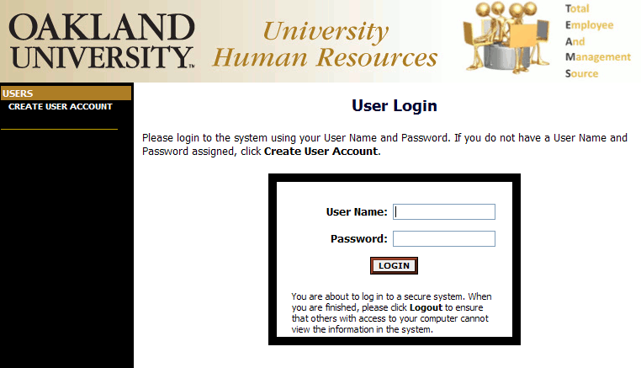
University Human Resources

Slide 32
University Human Resources
Helpful Tools
Administrative Policies and Procedures – Policy 770 – Temporary Employees and Casual Employees
Managers’ Toolkit (UHR website) – Getting Started – Creating an Employment Requisition for a Temporary or Casual Position

Slide 33
University Human Resources
Department Responsibility
Insure that requisition is complete with appropriate information
Funding available?
Forward for approvals
Direct new hire to UHR for on-boarding paperwork

Slide 34
University Human Resources
Department Responsibility
When the requisition is authorized and approved and employee has completed paperwork, UHR will email authorization to begin work.
DO NOT allow employee to begin work without authorization from UHR.

Slide 35
University Human Resources
Staff Payroll Cycles
Hourly – Department submits a time sheet with the hours worked. This occurs every other week.
Monthly – (exception basis only) Employee is paid a set amount per month.

Slide 36
University Human Resources
Ending Assignments
Temporary: 6 month maximum
Casual: 19 hours per week maximum
Termination or Change of Status
Rehires

Slide 37
Accounts Payable / IC vs Employee
Consultant (Independent Contractor) or Employee?
All individuals should be considered employees unless independent contractor status can be proven.
Status should be determined before work begins and before entering into an agreement for services to comply with E-Verify.

Slide 38
Accounts Payable / IC vs Employee
Consultant (Independent Contractor) or Employee?
To determine if your payee can be considered an Independent Contractor, you must complete a Classification Checklist, which will be part of the updated version of OU AP&P 262 in April 2010.
Contact Jim Ollar at ollar@oakland.edu or X2357 to obtain the checklist until the new policy is published.

Slide 39
Accounts Payable / IC vs Employee
Consultant (Independent Contractor) or Employee?
Jim Ollar will make the classification determination within 5 business days of receiving the checklist and email the final determination to the department.
The approved Classification Checklist indicating that the payee is not an employee is now a requirement to pay independent contractors through Accounts Payable.

Slide 40
International Students & Scholars
ISSO Categories
STUDENTS
Levels = PhD, Graduate, Undergraduate, (ESL not allowed to work)
Visa types handled by ISSO
F-1 = Degree-seeking student
J-1 = Exchange student (one or two semesters)
Change of Status Application to F-1 (usually from H-1b work visa, H-4 dependent status )
SCHOLARS
J-1 Exchange Visitor Visa
Sponsored by a department and/or faculty member
Duration of stay at OU
Short-term = 6 months or less (may not be extended)
Long-term = more than 6 months

Slide 41
International Students & Scholars
International Student Employment
On-campus
20-hours(not 25 like domestic students) limit total per week for all work (Fall and Winter, Undergraduate and Graduate)
40-hour limit during summer
Graduate Assistantship – Processed cooperatively through Graduate Study and ISSO to ensure no violations of Fall/Winter 20-hour limit
J-1 Exchange students must have prior ISSO approval to work
(The J-1 student Employment tracking form must be turned into the ISSO)
ISSO changes international mailing addresses (local, primary, FO, HR, Billing) EXCEPT not University Housing OR Payroll, which requires department to initiate and authorize
H-4’s and F-2’s are not allowed to work! J-2 dependents can only work with prior approval from USCIS and the ISSO

Slide 42
International Students & Scholars
III. J-1 Processing Administrative Departments
Academic Human Resources (AHR) : J-1 Scholars at OU for more than 6 months
University Human Resources (UHR) : J-1 Scholars at OU for 6 months or less
International Students and Scholars Office (ISSO) : F-1 and J-1 Students and J-1 Visiting Scholars
Sponsoring Academic Departments
Auxiliary Departments
Payroll (Departments must authorize pay check address changes)
Graduate Study (CPT Employment applications)
Housing
Graham Health Center
Admissions (students only)
Dean’s Office generates for scholars only the G#
Social Security number request (There is a 10 day waiting period for applying from the date of arrival in the U.S.)

Slide 43
International Students & Scholars
J1 Scholar Process Flow Chart
Stage I – Initiation of prospective hire by Sponsoring Professor/PI (Principle Investigator)
Stage II – Authorization by Dept. Chair
Stage III – Generation of Letter of Offer by Dean’s Office at request of Dept. Chair
Stage IV – Circulation of DS-2019 Application form for authorization signatures
Stage V – Submission of DS-2019 Application to ISSO
Stage VI – Departmental preparations for J-1 Arrival
Stage VII – J-1 “Post-Doc” Academic Researcher Arrival
Stage VIII – Duration of Stay
Stage IX – Departure (ISSO Exit survey)
Stage X – Return possibilities

Slide 44
International Students & Scholars
J1 Scholar Scenarios
A professor meets a talented chemistry post doc at a conference in the Ukraine with funding from his Govt. and they discuss him coming to work at Oakland University for six months.
The professor completes the J-1 application for visiting scholars and professors and he requests a short term visiting scholar stay. He secures an offer letter for the Dean of his school and the other required signatures. He then submits all the complete paperwork to the ISSO for processing. Two weeks later, the DS-2019 is sent to the scholar at the home address indicated on the ISSO request form.
The professor arrives and has his initial visit with the ISSO advisor and purchases OU/ISSO sponsored Maksin insurance at rate of $144 per month for six months and is then registered in SEVIS. He gives the ISSO his G# which was processed by the Deans office. He now has an active file in the ISSO.
A professor wants to hire a scholar from China and completes the J-1 application for visiting scholars and professors. Then, he processes the paperwork through the Engineering Department and get the Dean’s offer letter along with all other signatures. The paperwork is submitted to the ISSO. This time the scholar is paid by a U.S. government grant and then meets with the ISSO for an initial visit. The scholar has a G number already processed by the Dean’s secretary and he is registered in SEVIS. The scholar is then taken down to the benefits office where his health benefits are explained. She then shows the ISSO proof of OU’s insurance and she purchases a $48 rider from the ISSO for medial evacuation and repatriation and she is all set.

Slide 45


Employment @ Oakland University

Slide 46
Employment @ Oakland University
Questions?

