Slide 1
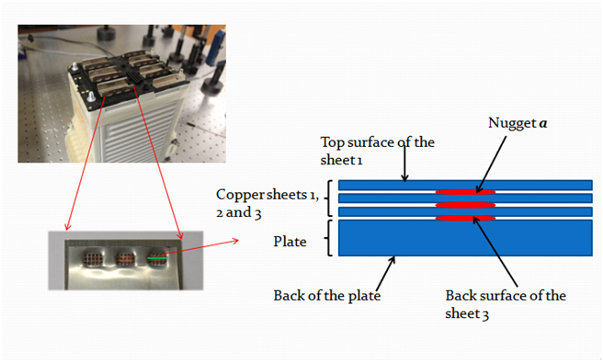
Oakland University student discovers
new method to inspect quality of spot welds
The Oakland University and School of Engineering and Computer Science communities are invited to attend XXXXXX’s defense of his Ph.D. dissertation. Seating is limited. RSVP with Haroldeane Perzyk at perzyk@oakland.edu.
Title
Committee: Name, Ph.D. (Chair), Name, Ph.D.,
Name, Ph.D., Name, Ph.D.
Abstract Abstract Abstract Abstract Abstract Abstract Abstract Abstract Abstract Abstract Abstract Abstract Abstract Abstract Abstract Abstract Abstract Abstract Abstract Abstract Abstract Abstract Abstract Abstract Abstract Abstract Abstract Abstract Abstract Abstract Abstract Abstract Abstract Abstract Abstract Abstract Abstract Abstract Abstract Abstract Abstract Abstract Abstract Abstract Abstract Abstract Abstract Abstract Abstract Abstract Abstract Abstract Abstract Abstract Abstract Abstract Abstract Abstract Abstract Abstract
Abstract Abstract Abstract Abstract Abstract Abstract Abstract Abstract Abstract Abstract Abstract Abstract Abstract Abstract Abstract Abstract Abstract Abstract Abstract Abstract Abstract Abstract Abstract Abstract Abstract Abstract Abstract Abstract Abstract Abstract Abstract Abstract Abstract Abstract Abstract Abstract Abstract Abstract Abstract Abstract Abstract Abstract Abstract Abstract Abstract Abstract Abstract Abstract Abstract Abstract Abstract Abstract Abstract Abstract Abstract Abstract Abstract Abstract Abstract Abstract Abstract Abstract Abstract Abstract Abstract Abstract Abstract Abstract Abstract Abstract Abstract Abstract Abstract Abstract Abstract Abstract Abstract Abstract Abstract Abstract Abstract Abstract Abstract Abstract
Time: 2-4 pm
Date: Tuesday, March 17, 2015
Location: 423 EC

